Slide 1


ERASMUS AT KUL?
I couldn’t have found anything better!!!

Slide 2
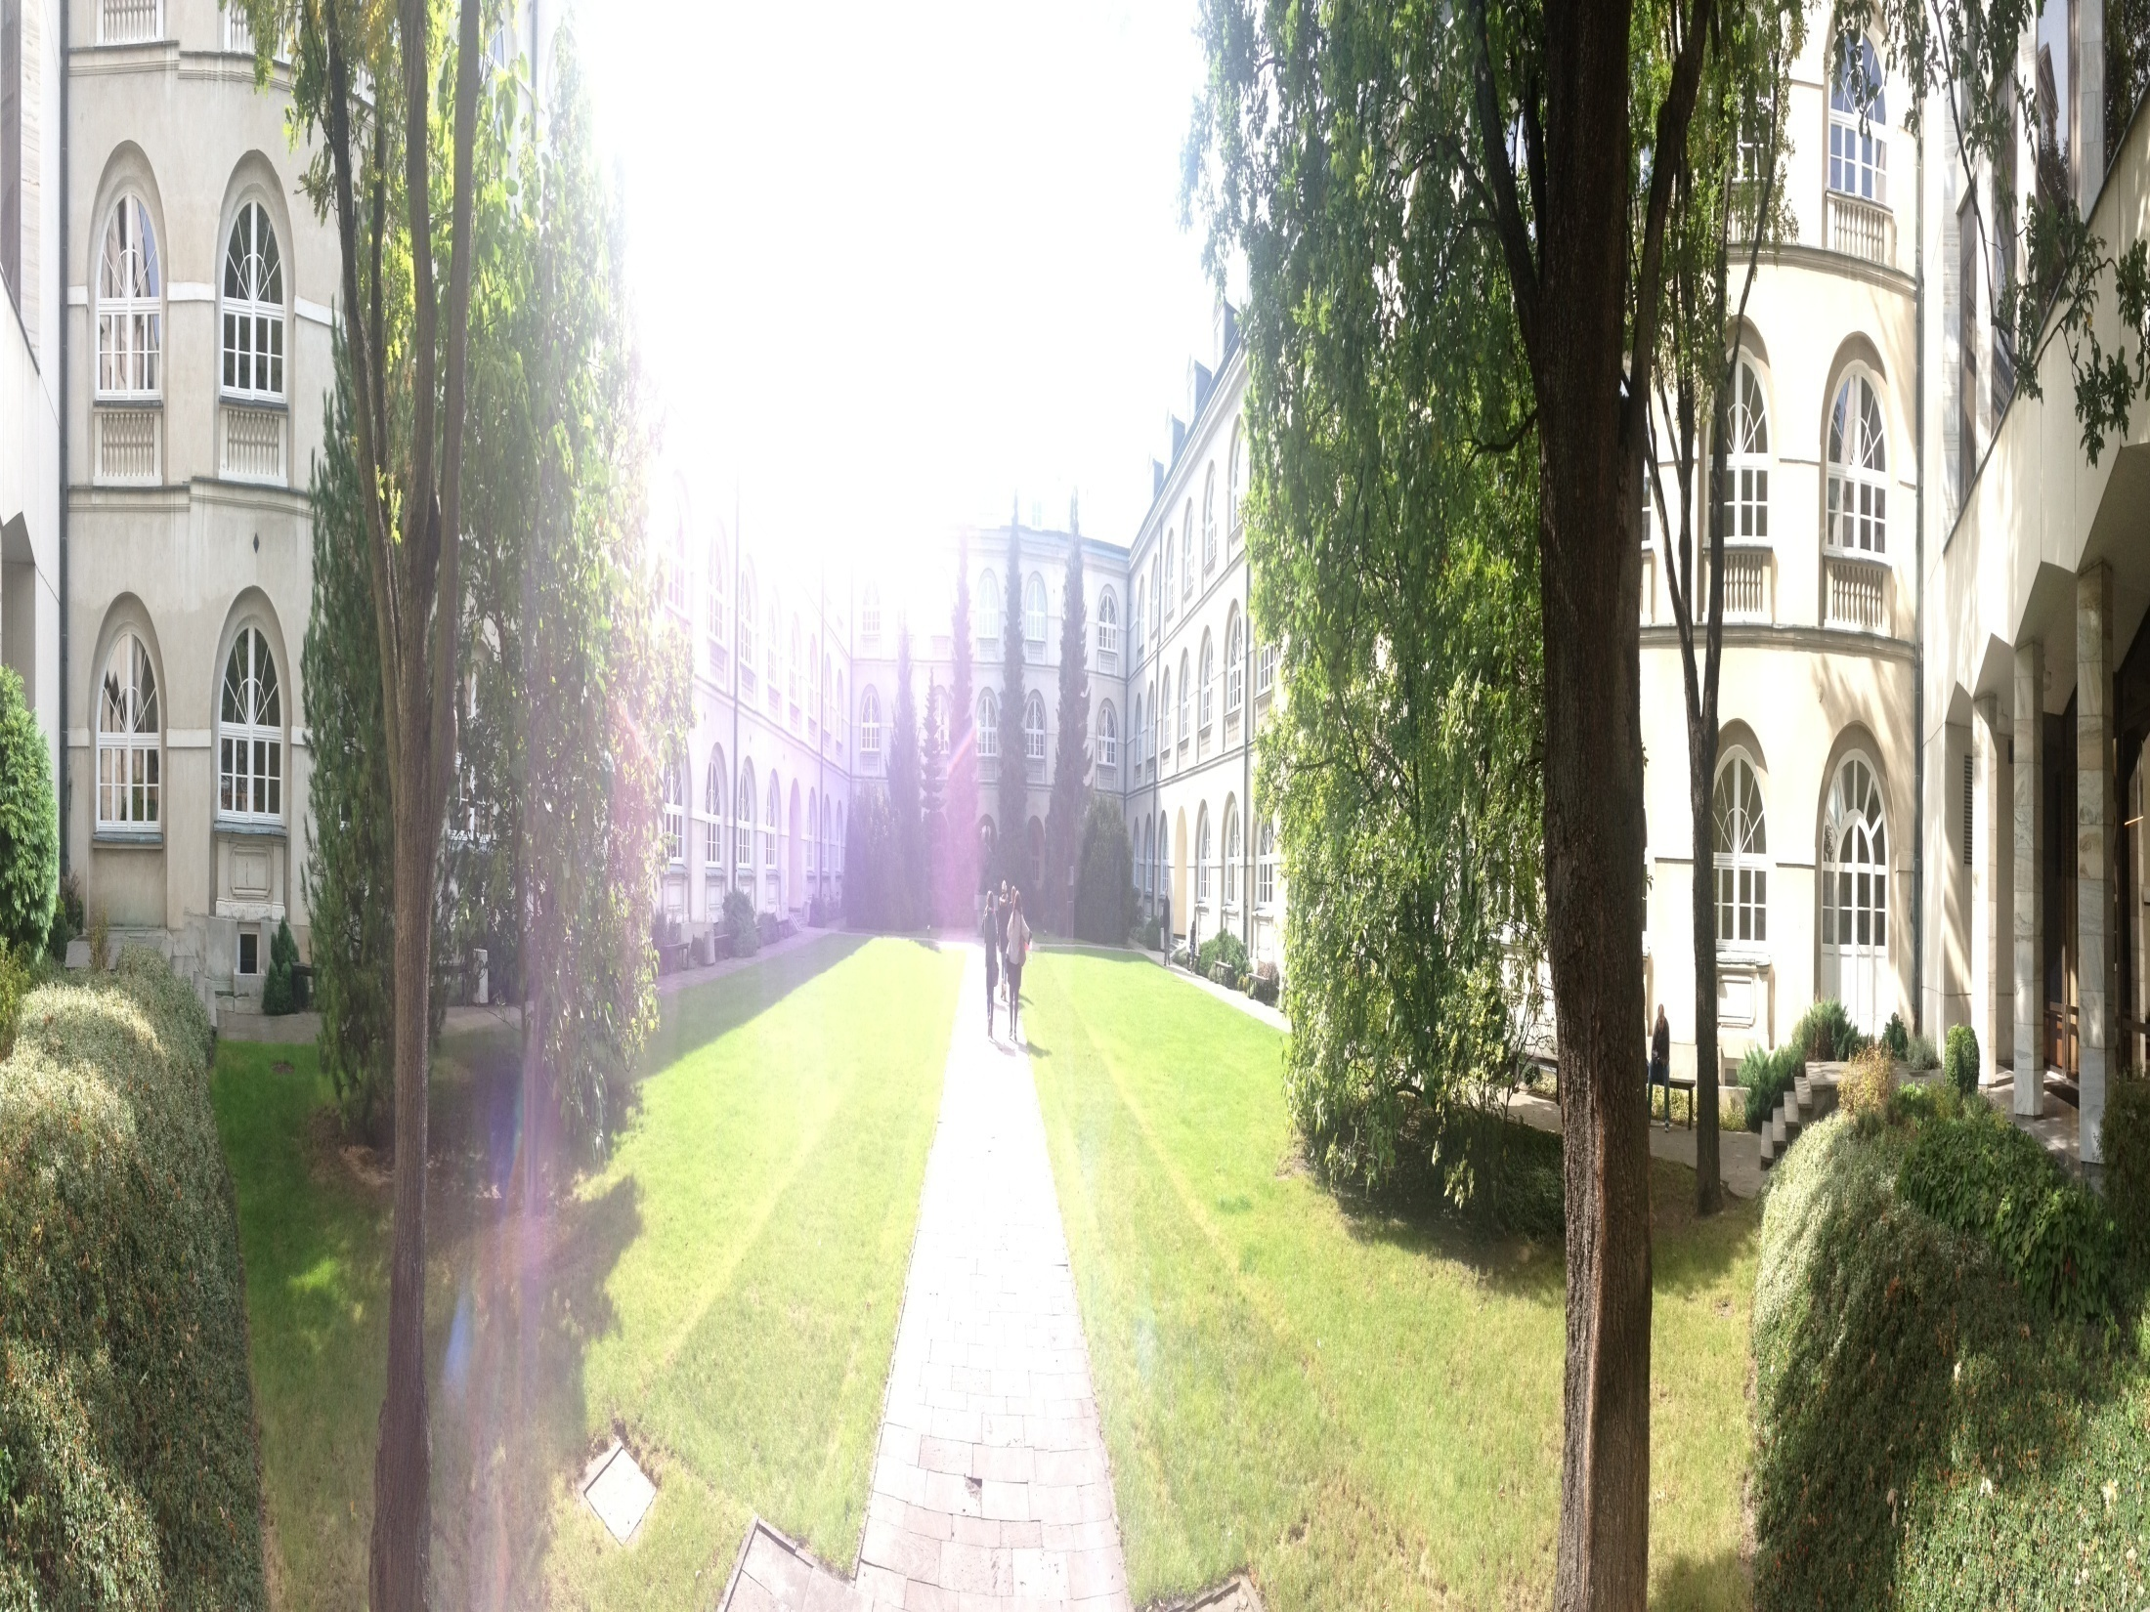

…a MAGIC place

Slide 3
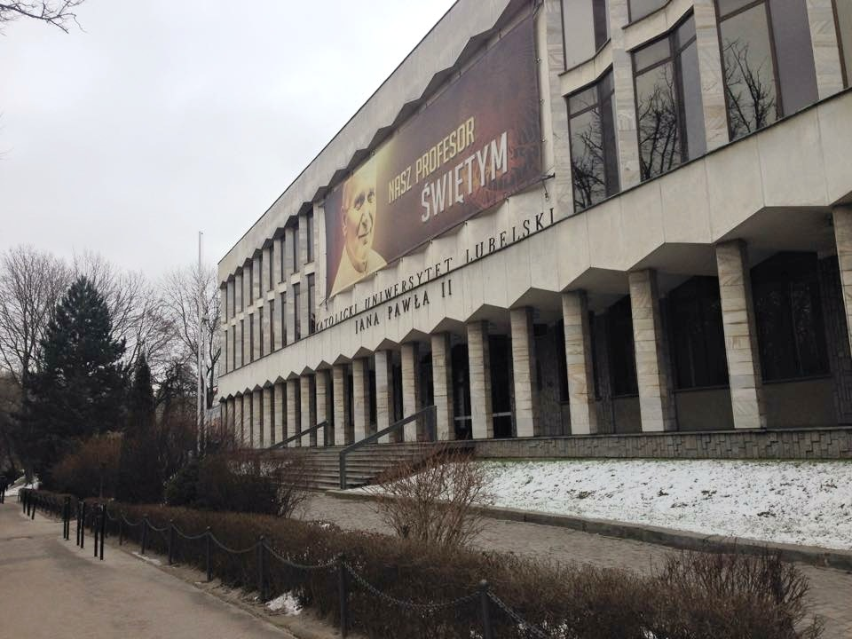
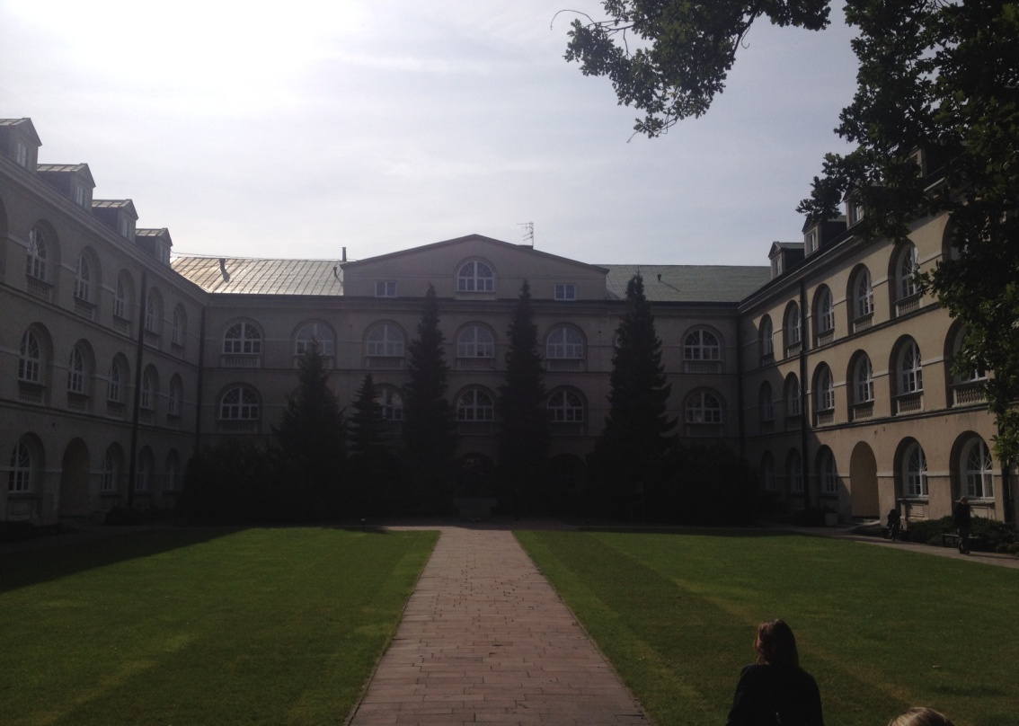
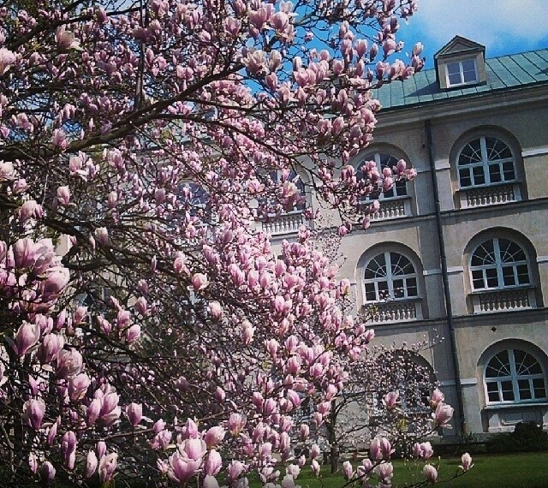
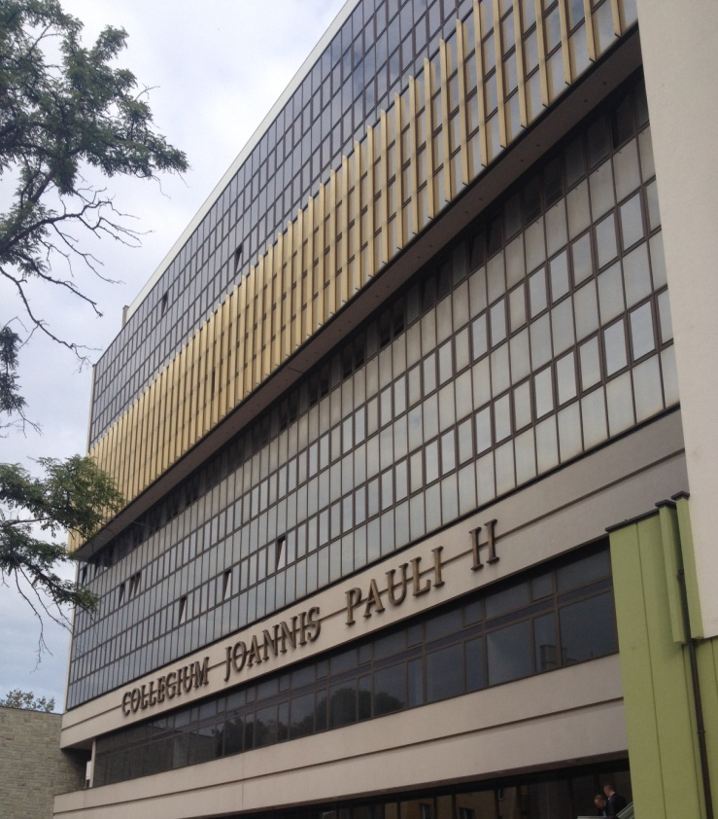
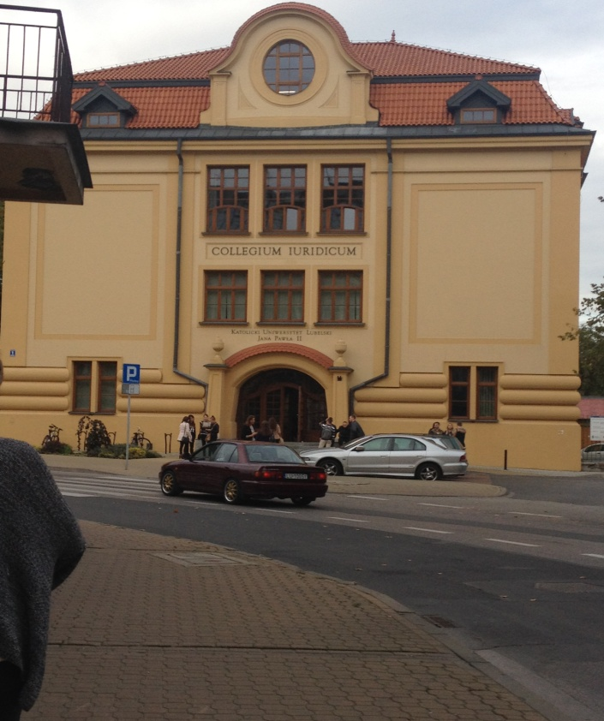

Slide 4
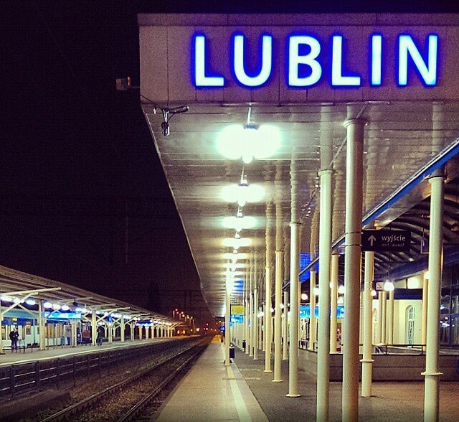
…in a MAGIC city

Slide 5
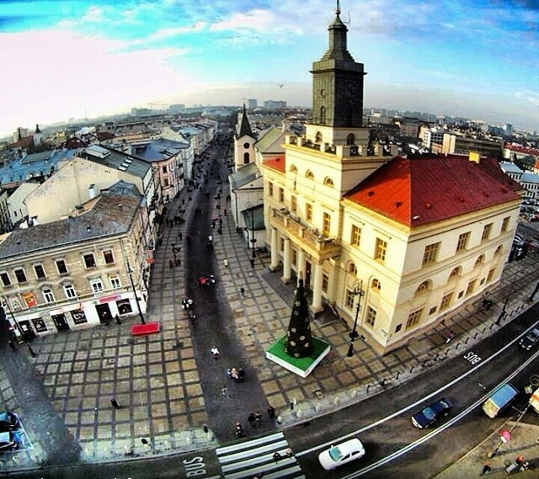
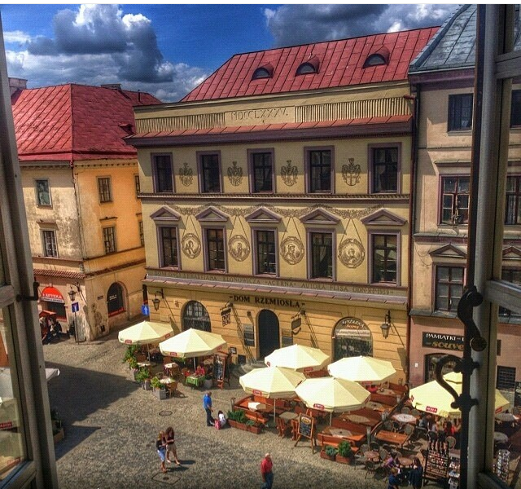
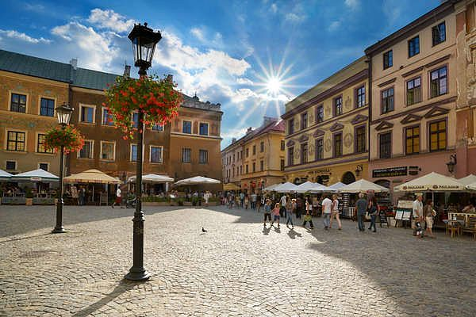
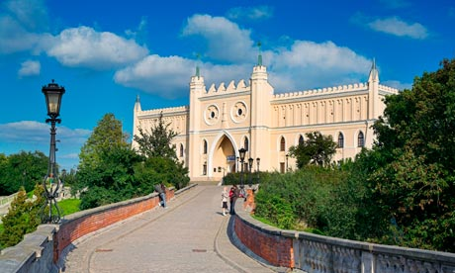
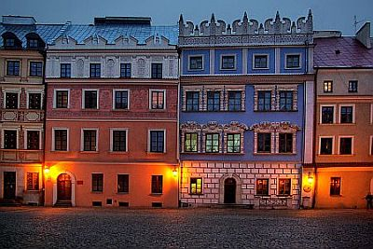

Slide 6
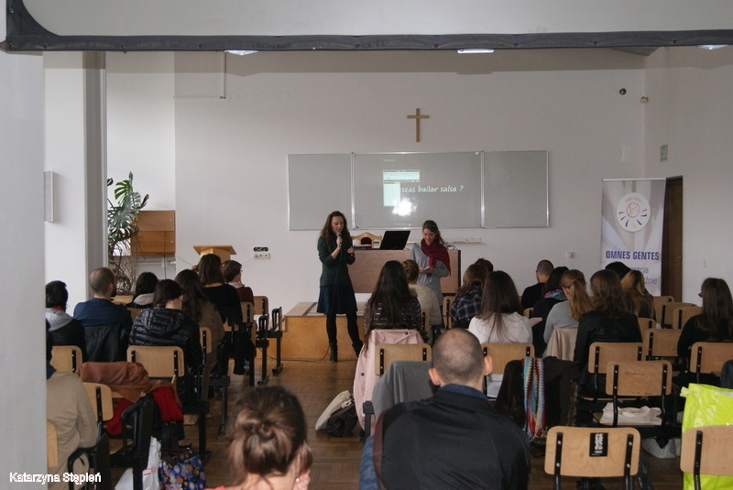
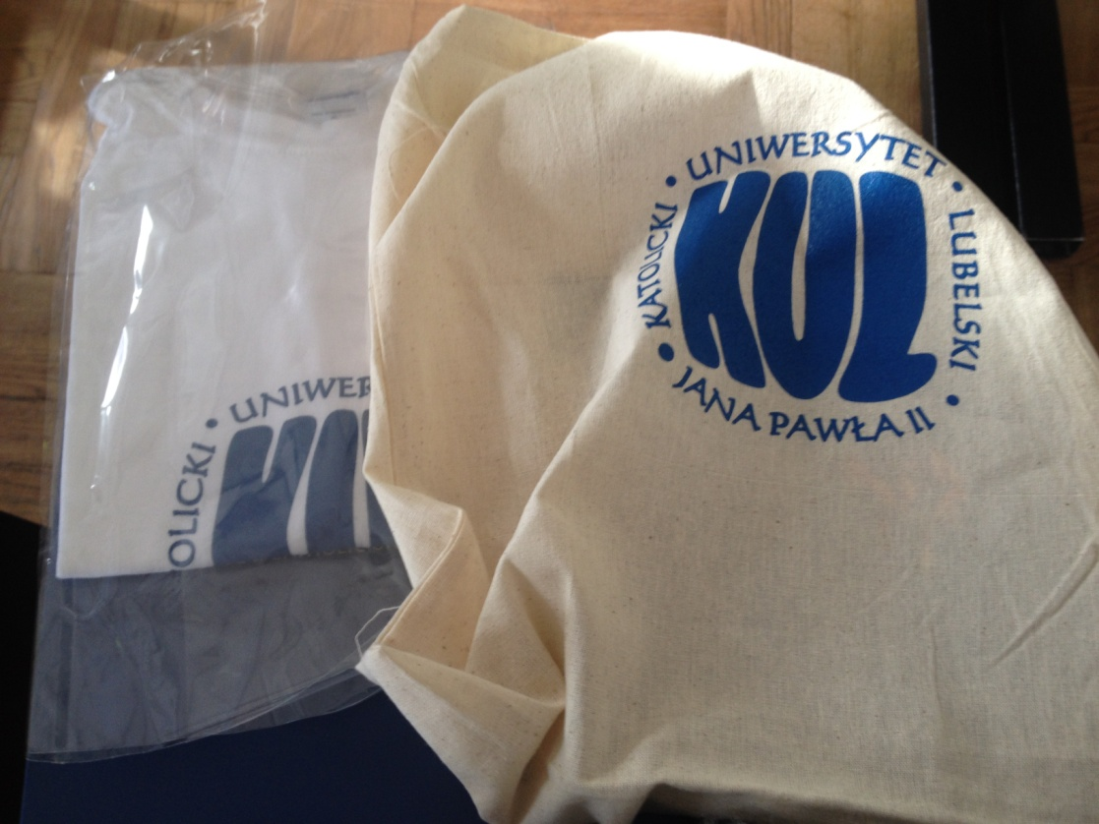
Fear? NO
Worry? NO
Loneliness? NO
KUL? YEEEES
Kul organized different integration events

Slide 7
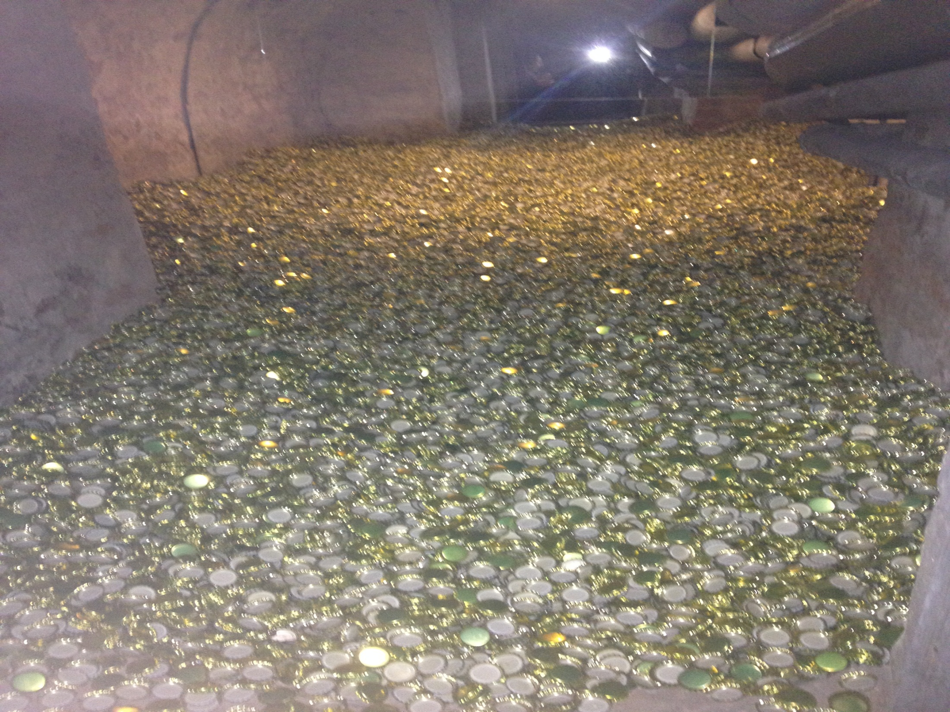
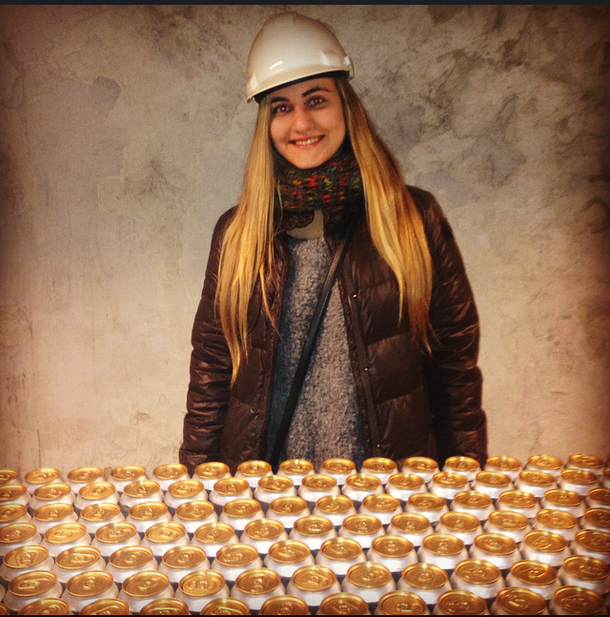

Slide 8
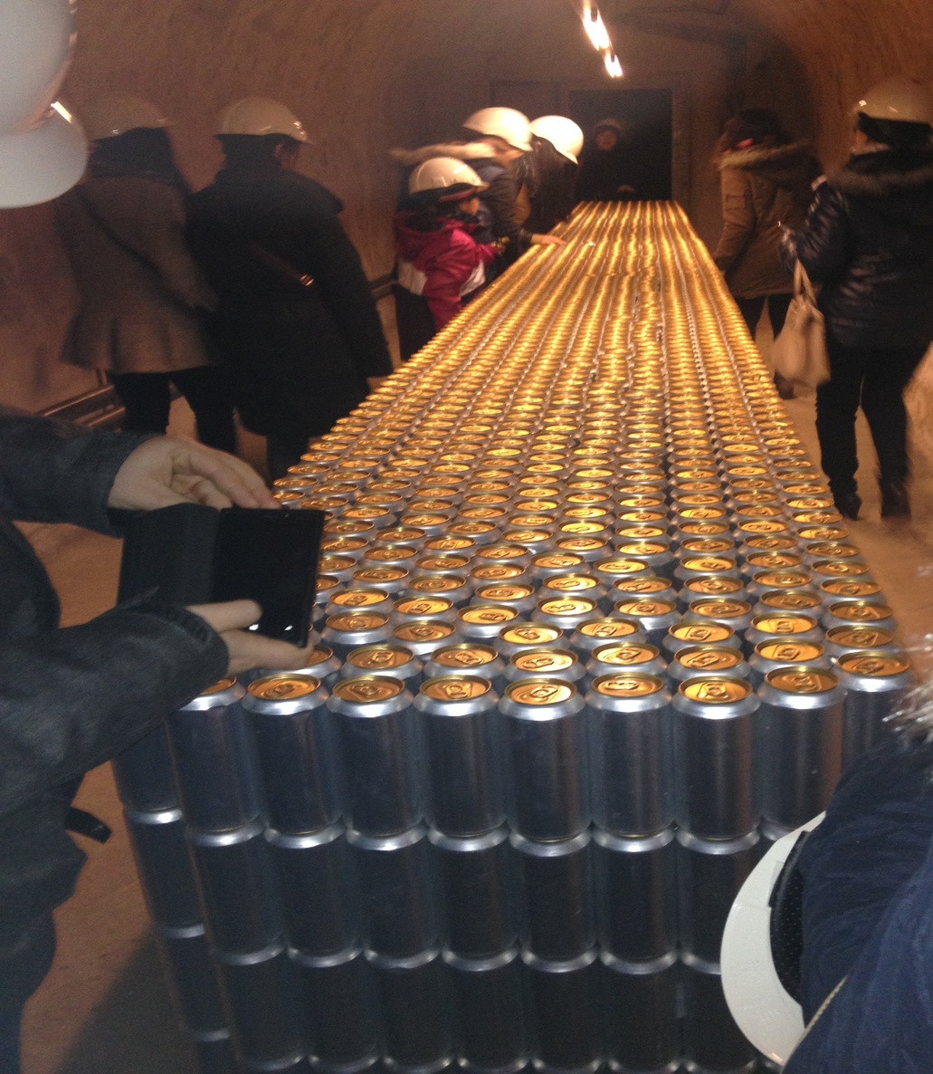
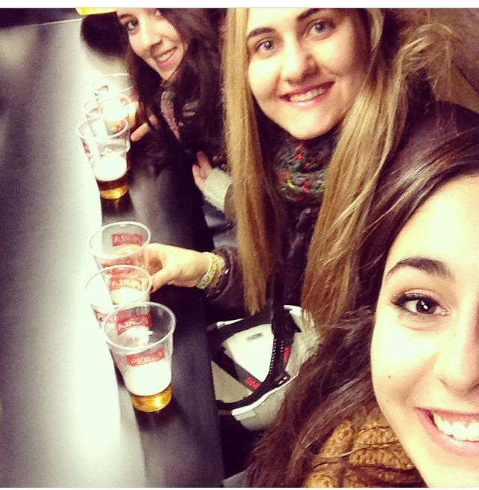
They helped me in EVERYTHING…

Slide 9
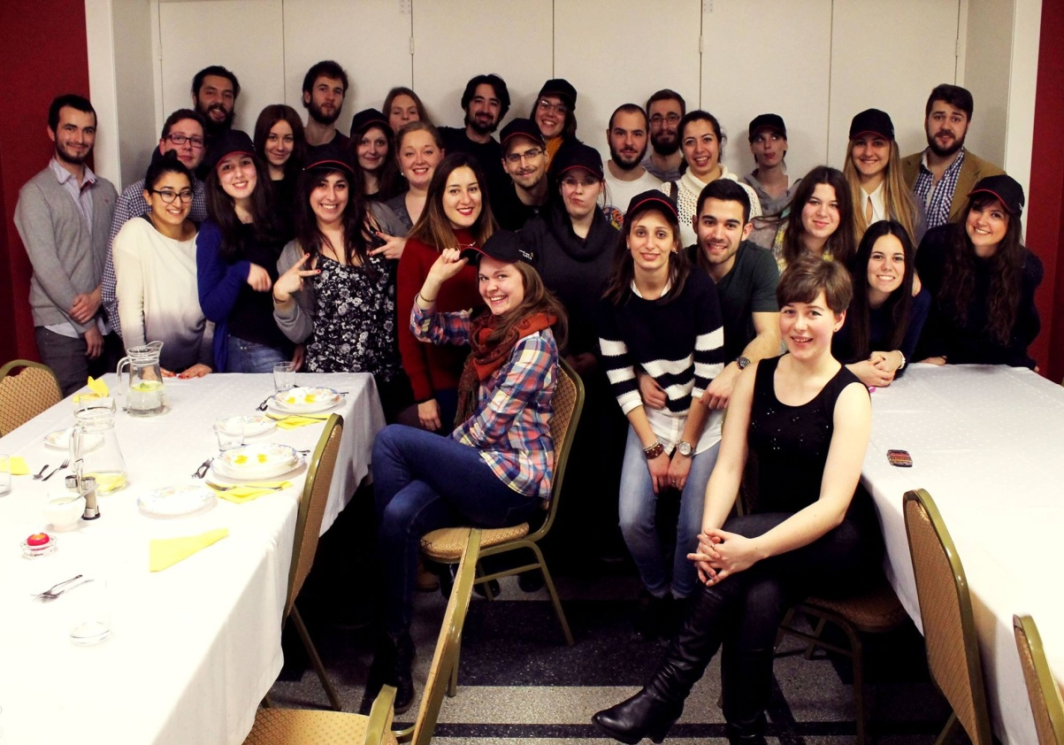
They made me feel at HOME…

Slide 10
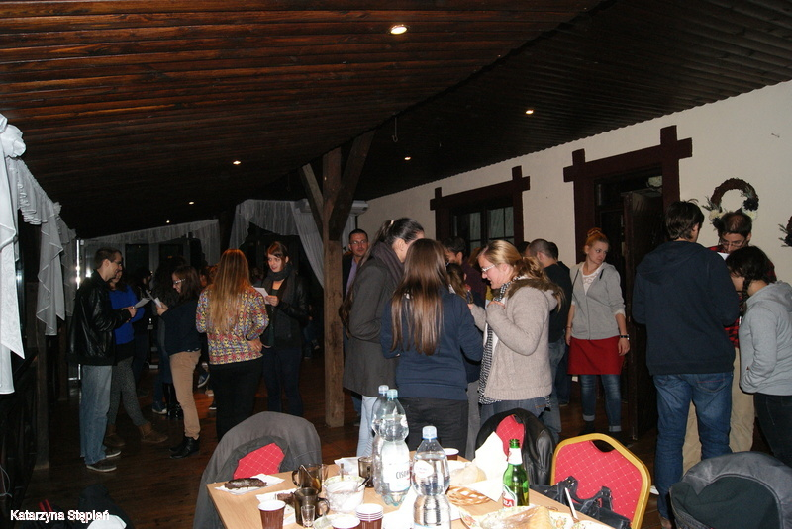
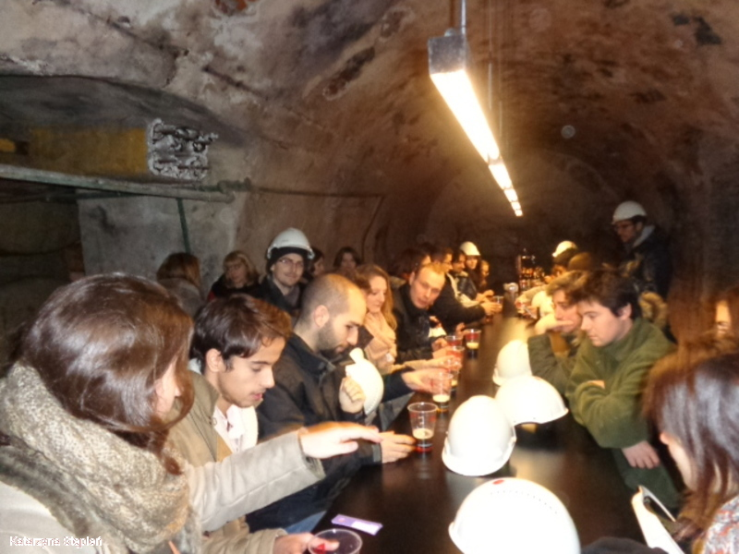
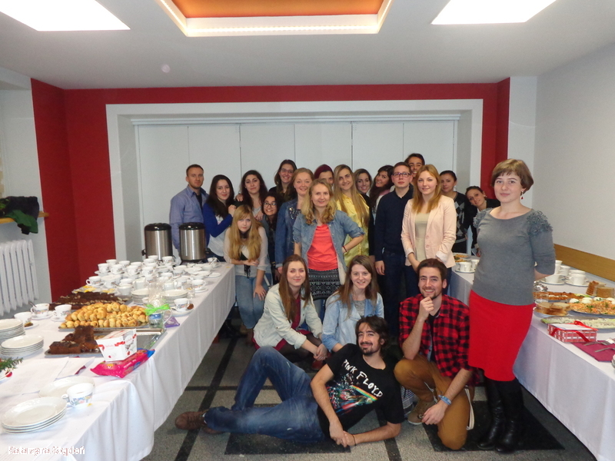
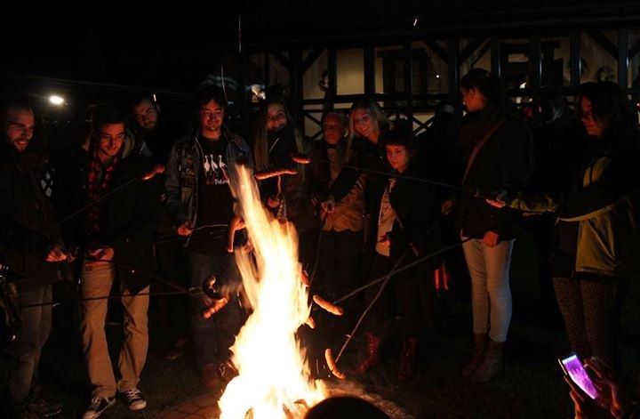
They let me INTEGRATE very well…

Slide 11
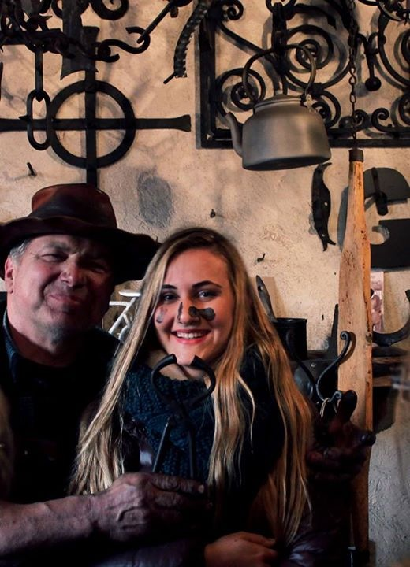
They also organized many trips…

Slide 12
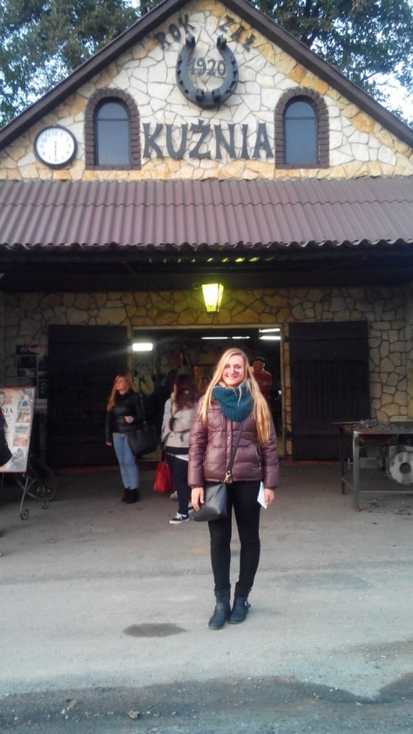
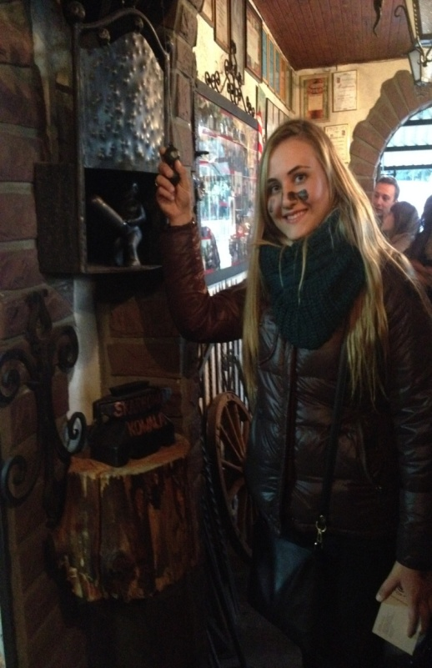
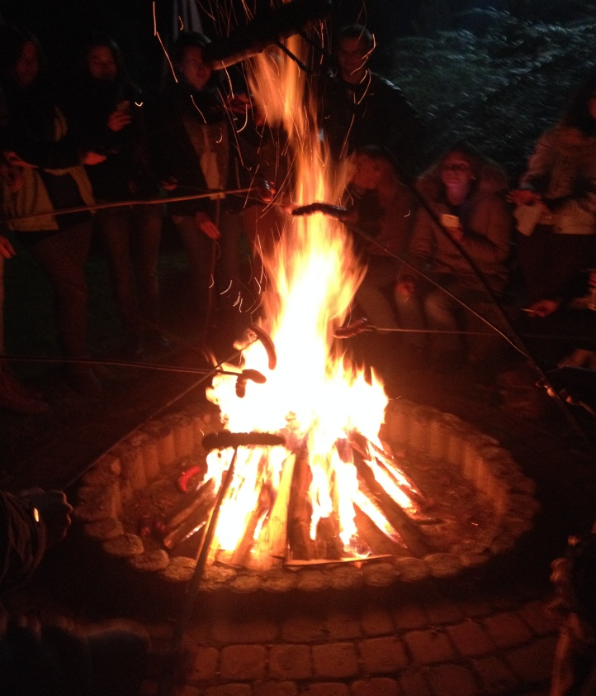
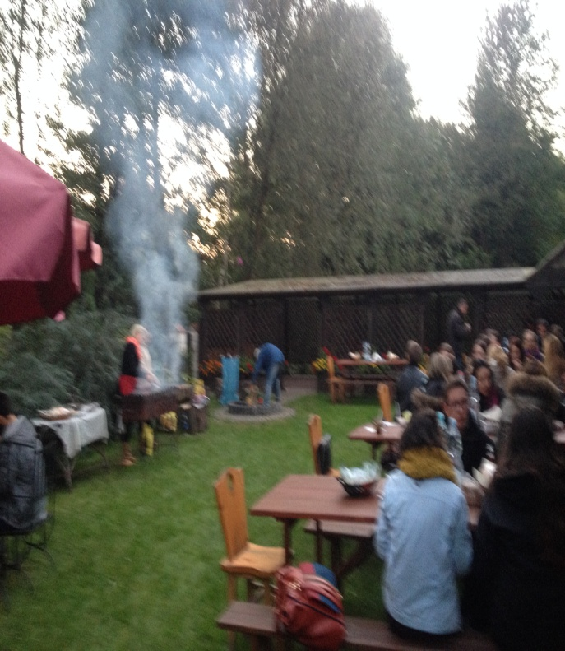
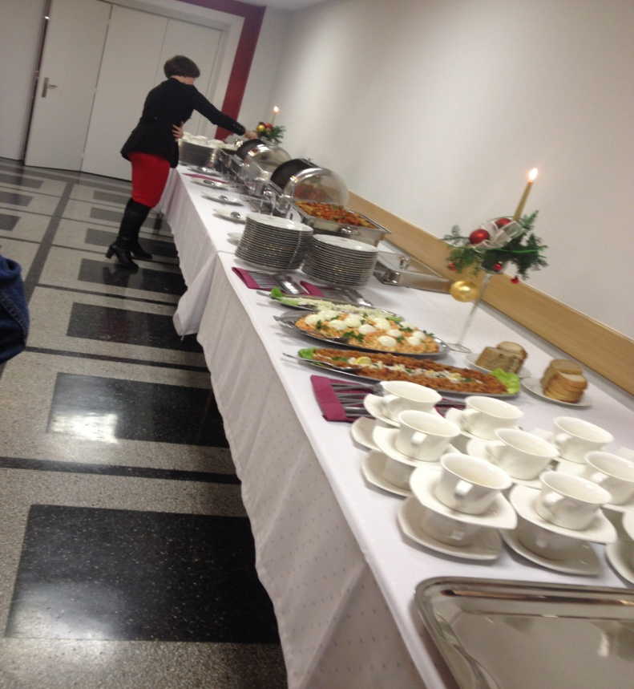
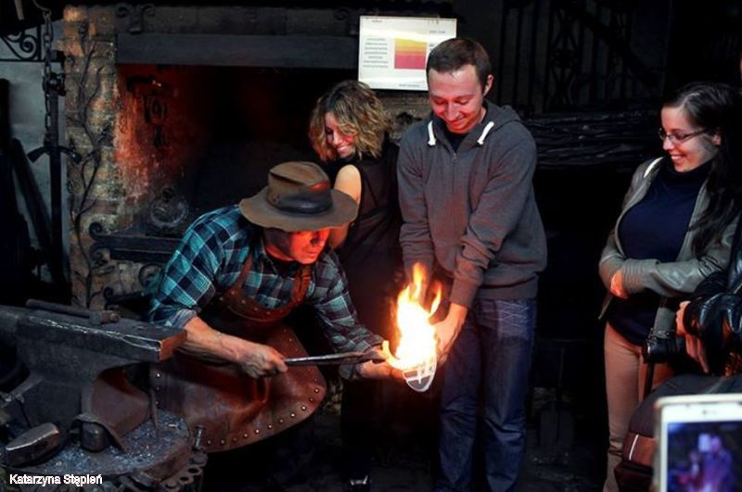
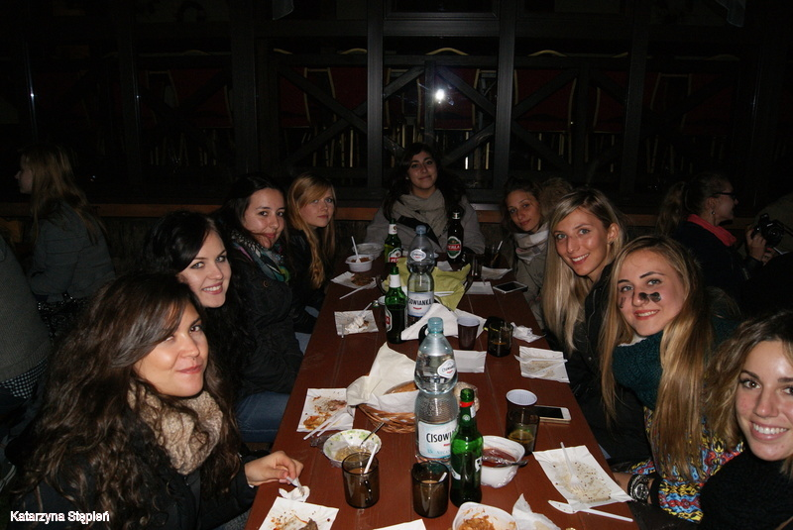
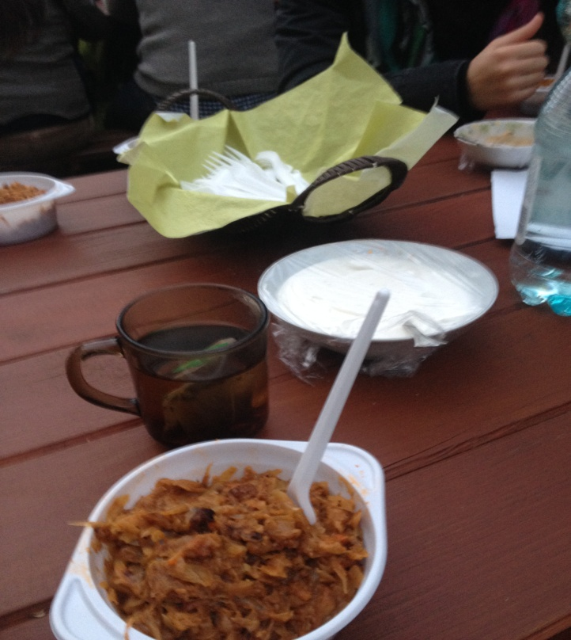

Slide 13
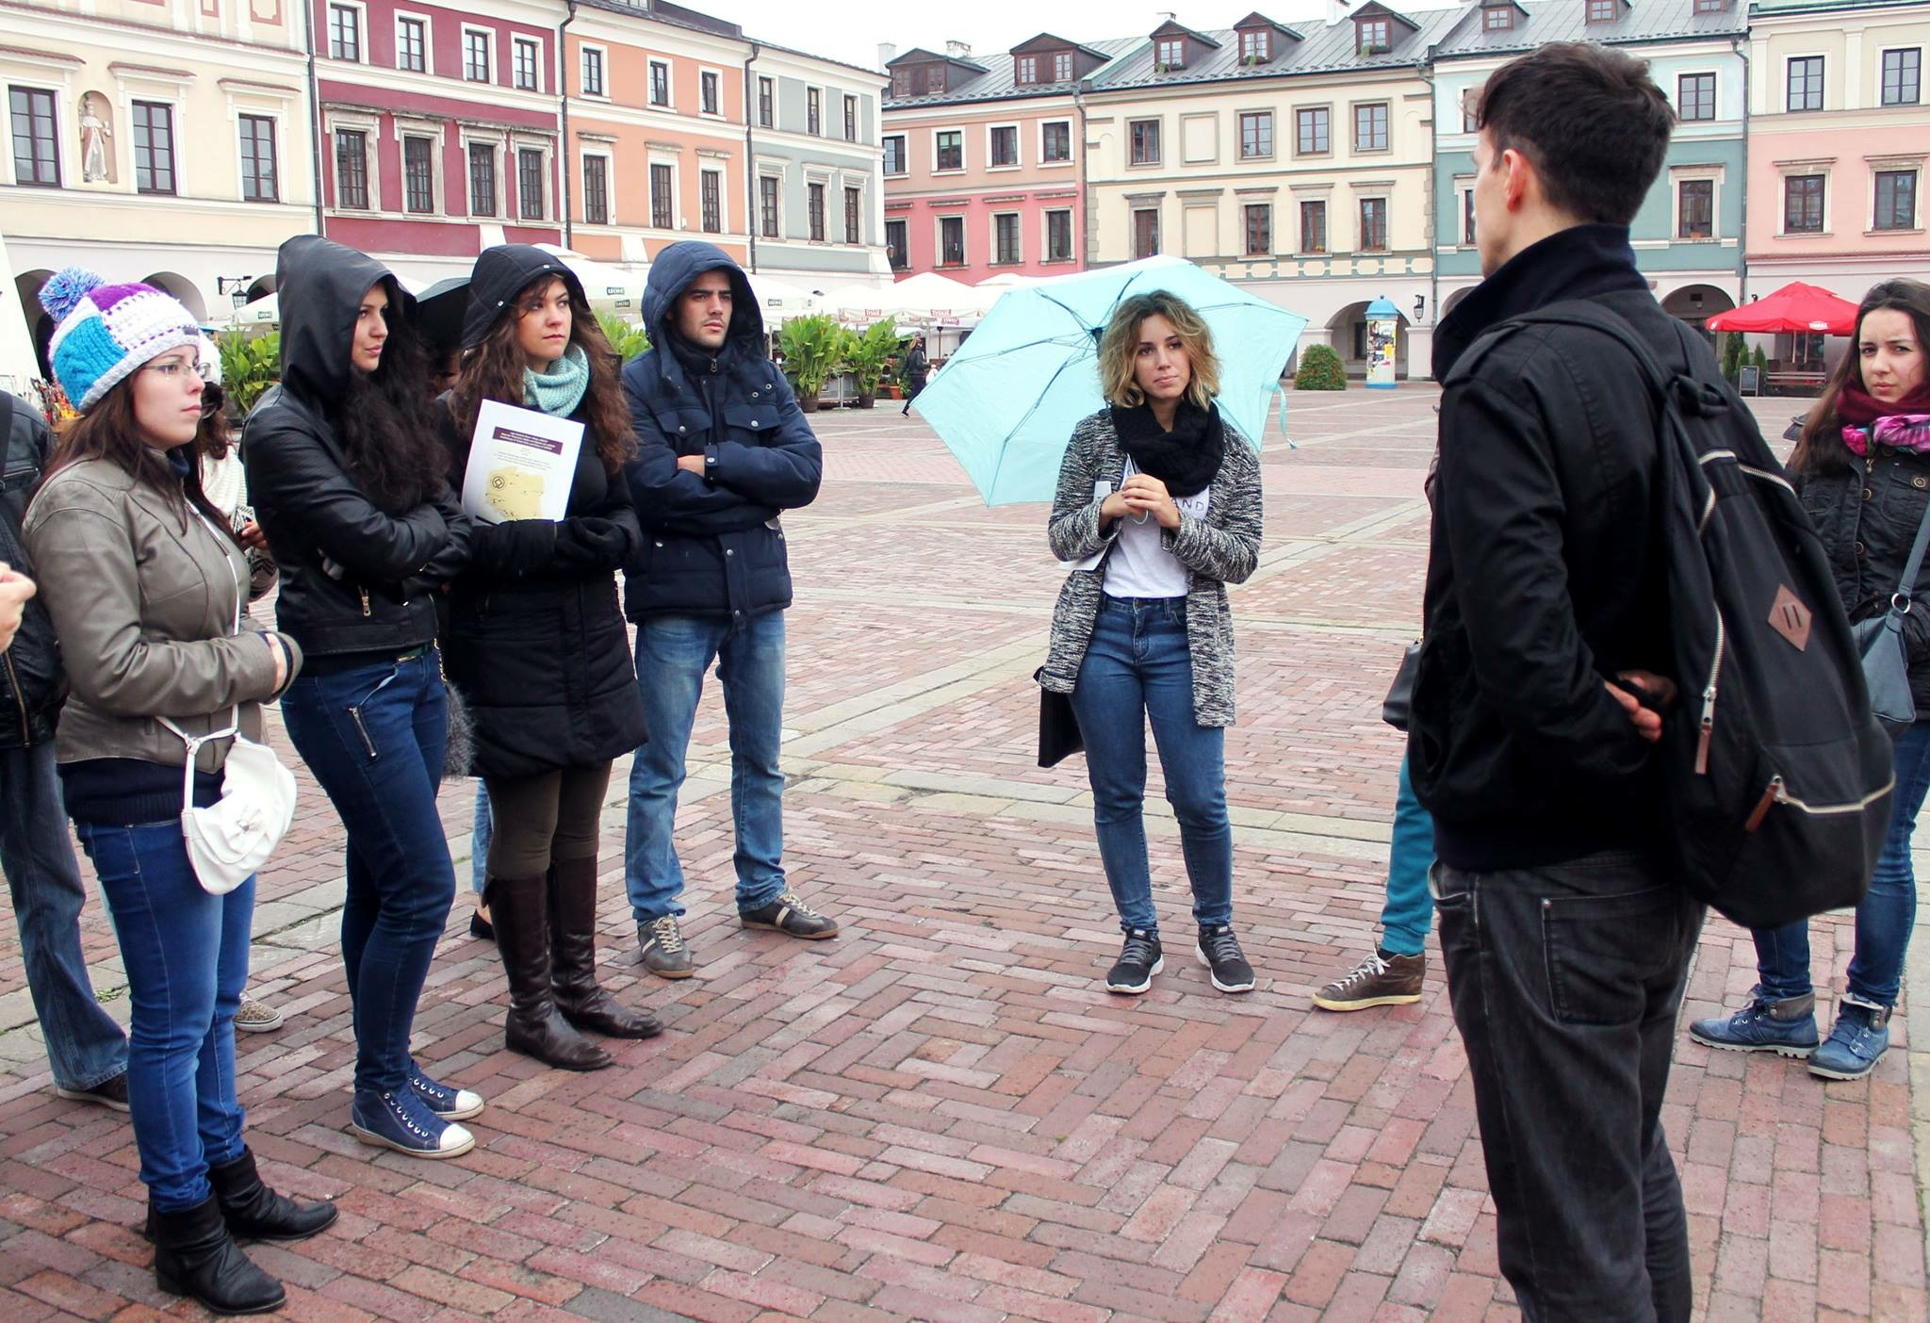
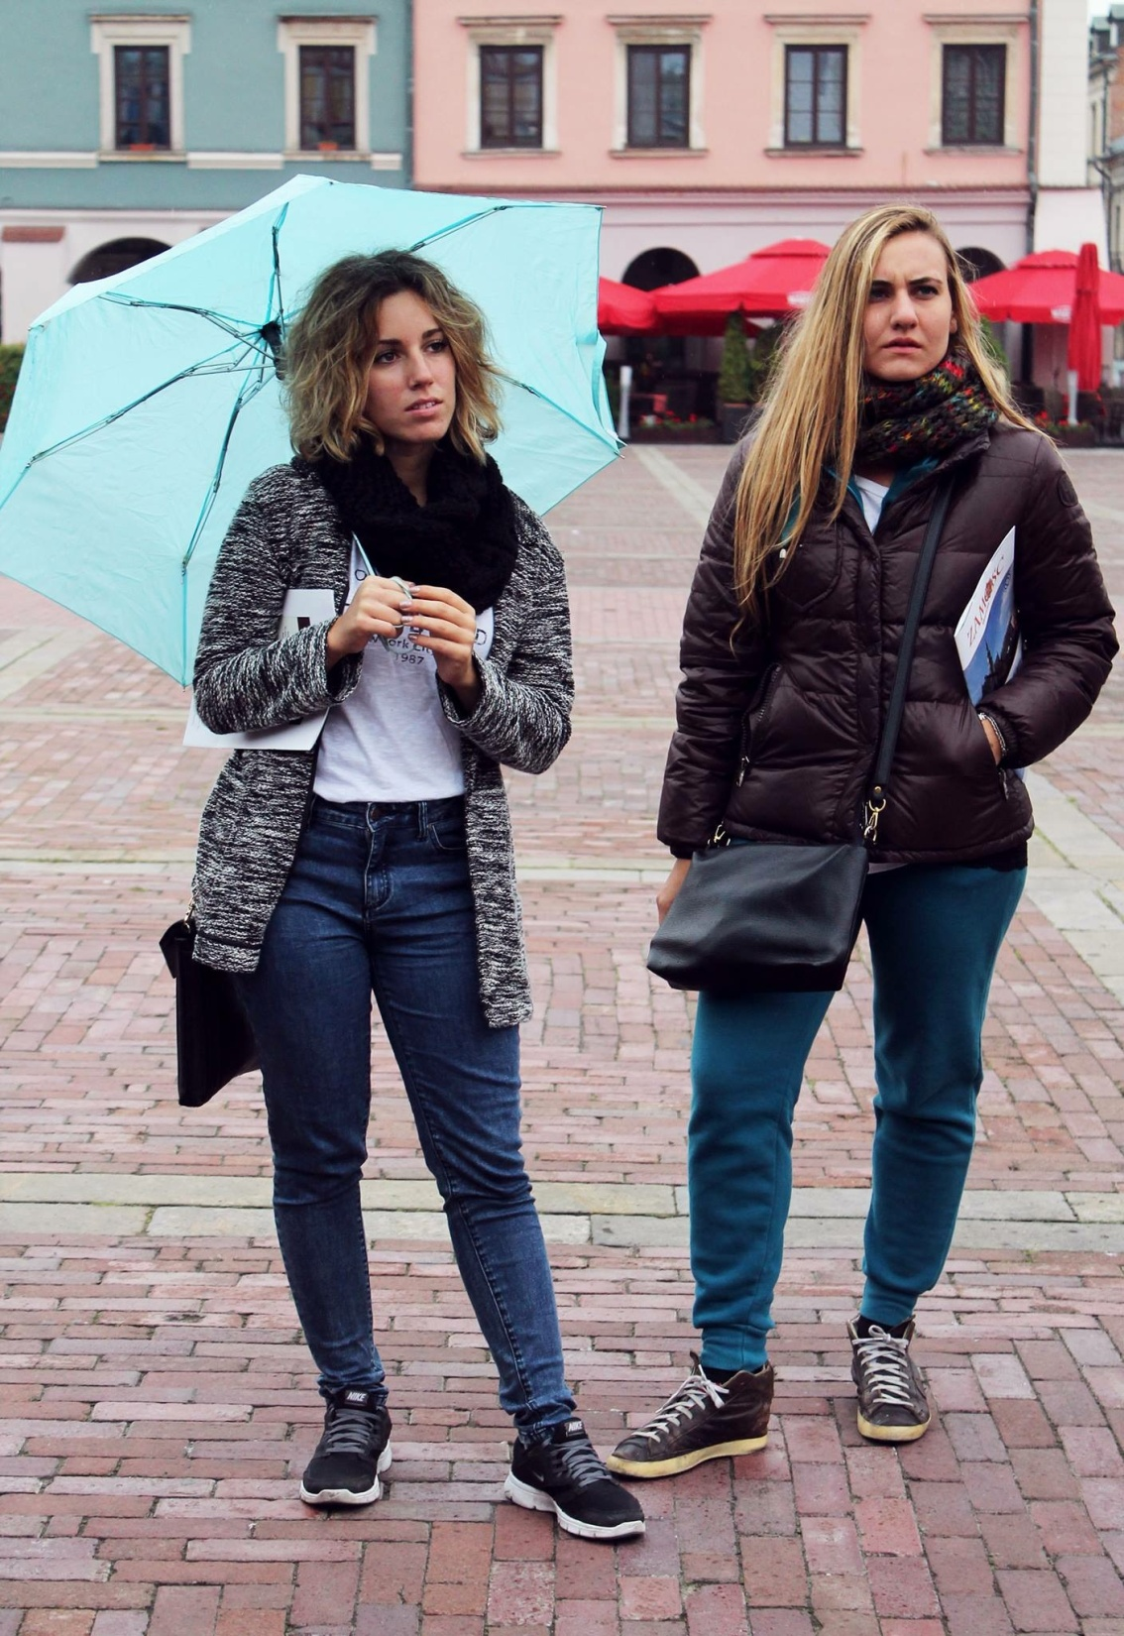

Slide 14
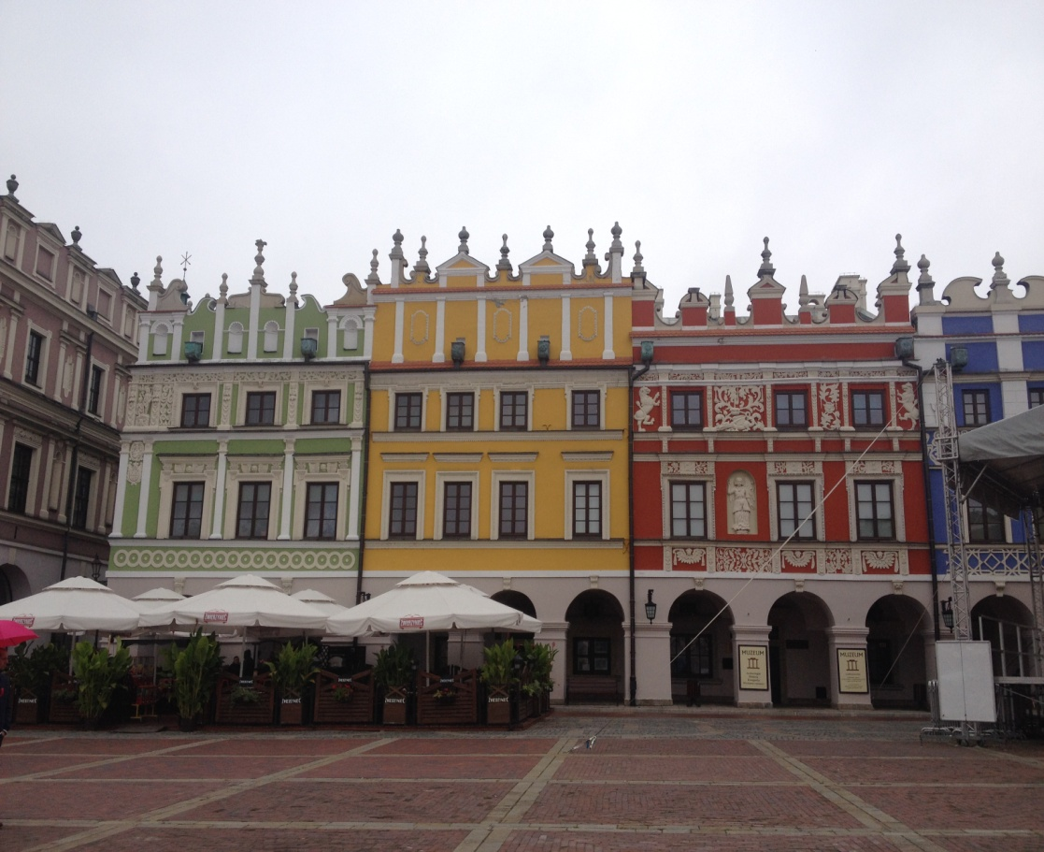
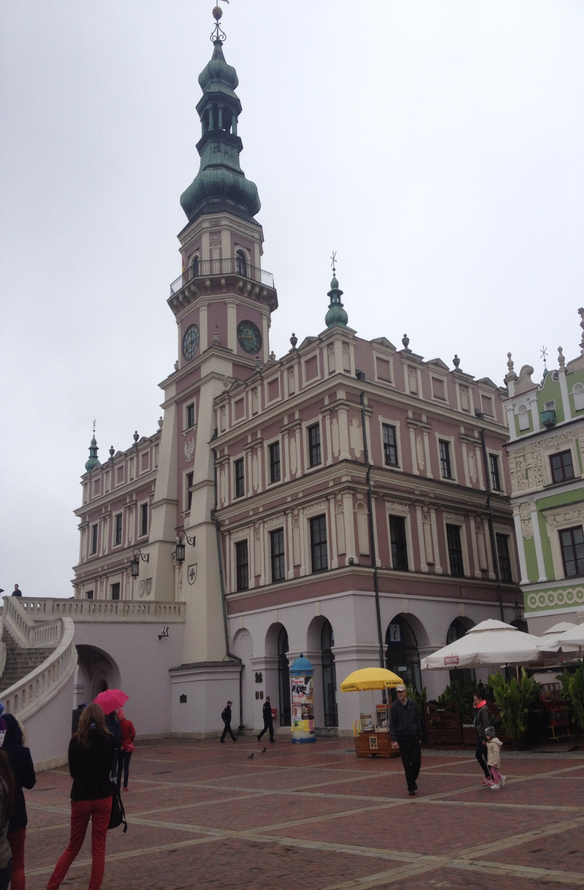
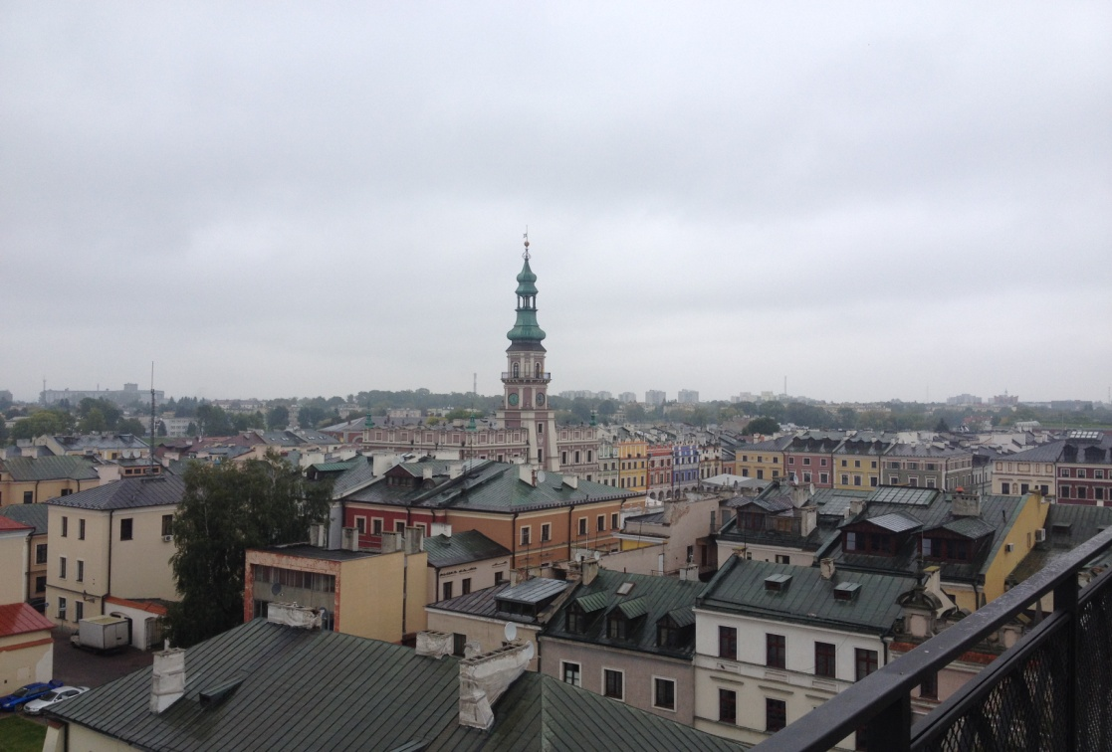
Everything was perfect!!!

Slide 15
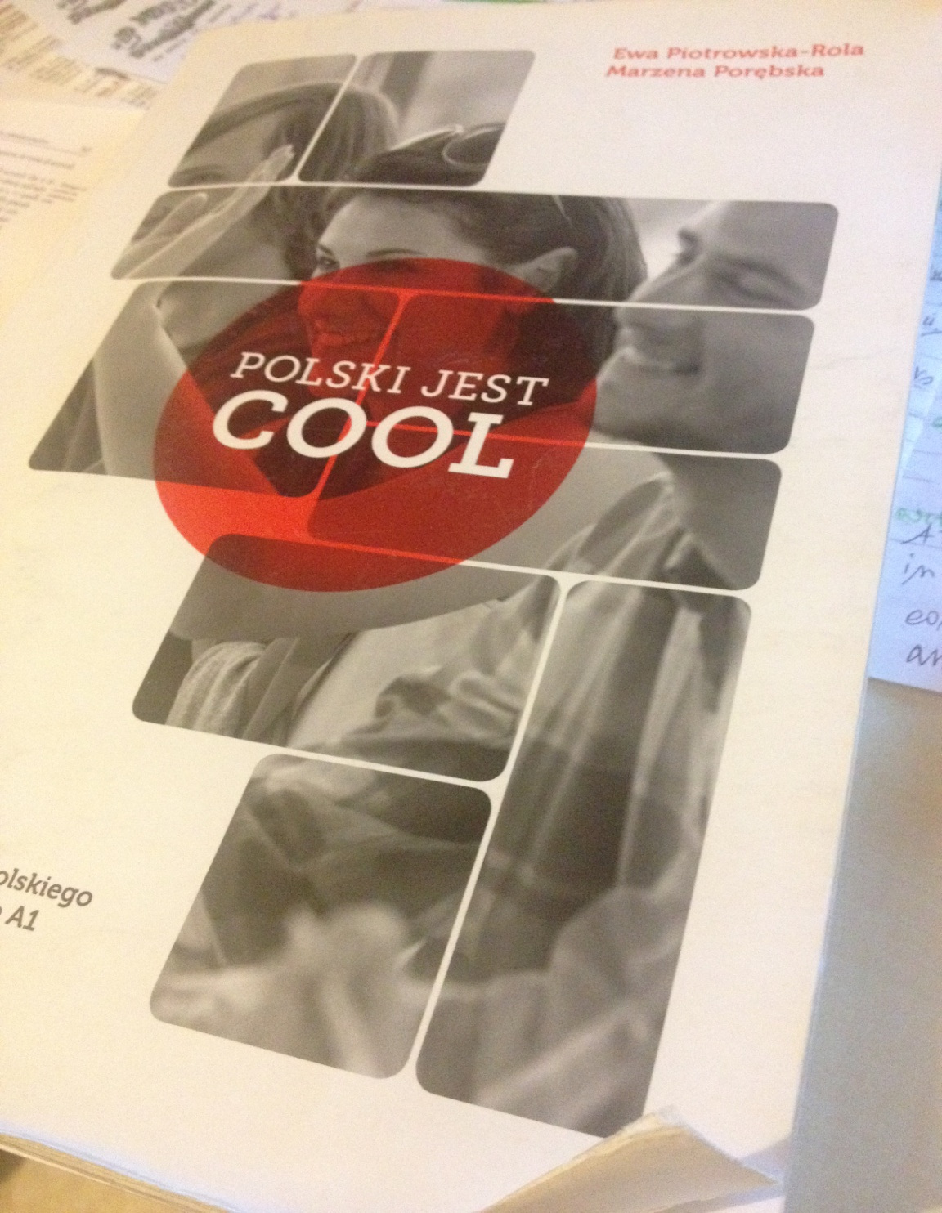
I took part in a free Polish language course…
Tak,
bardzo cool ☺

Slide 16
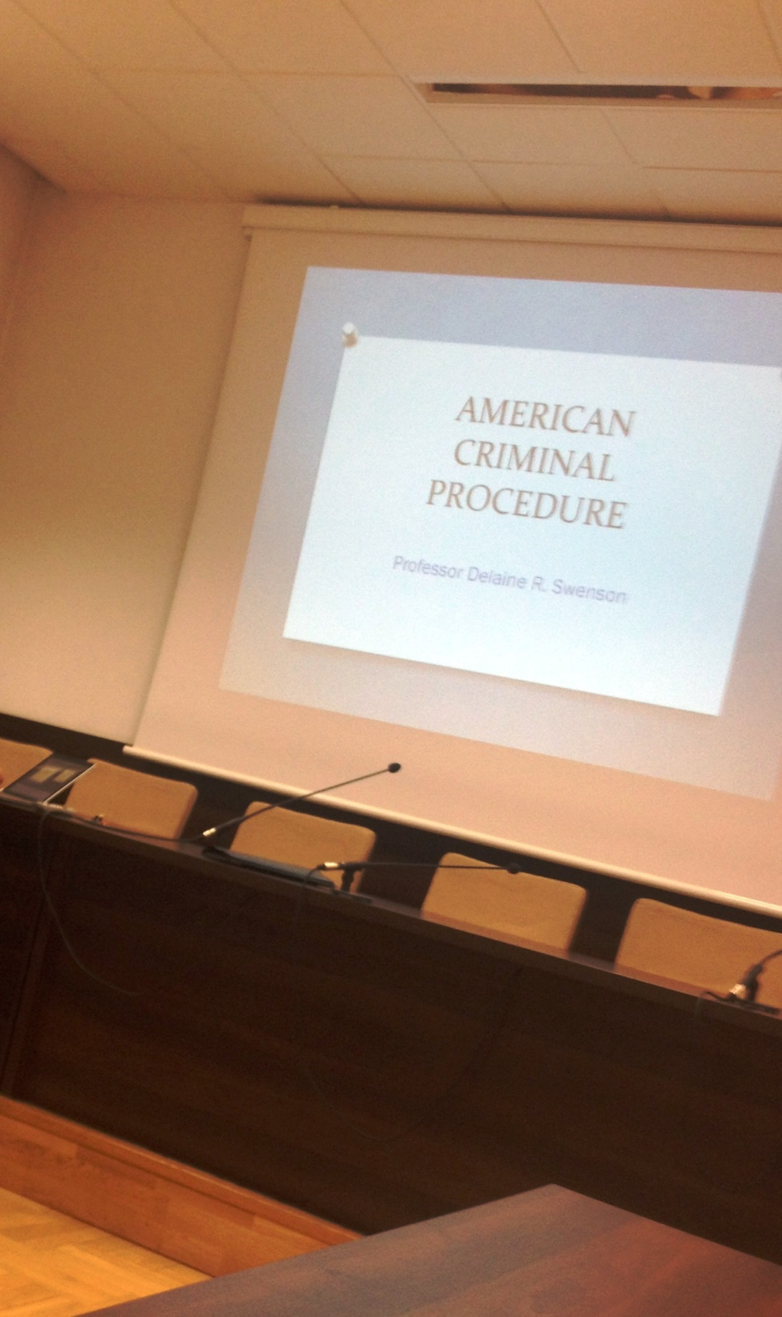
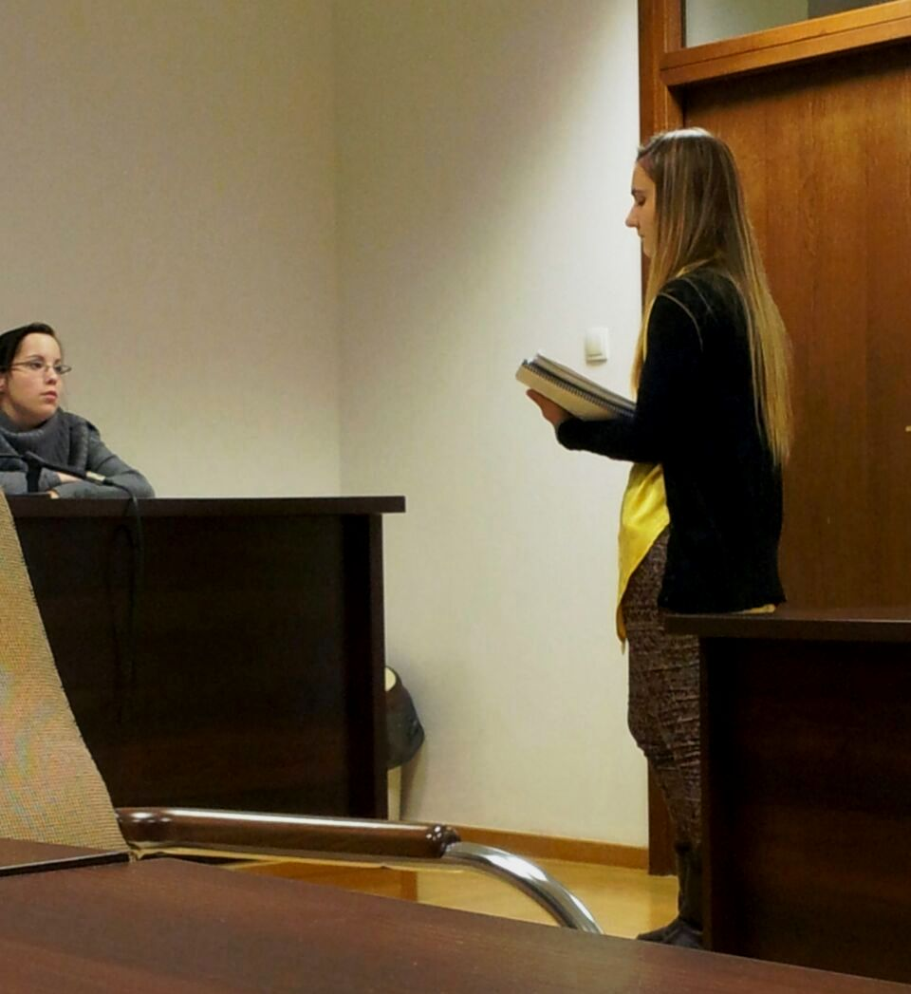
And in very interesting classes…

Slide 17
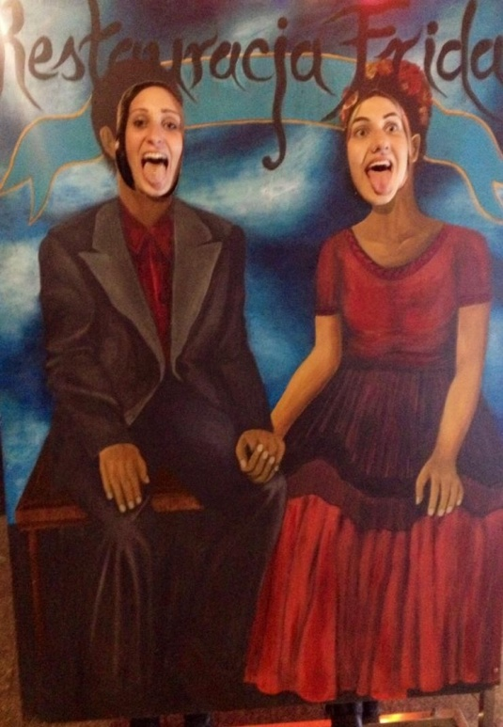

I spent UNFORGETTABLE MOMENTS…

Slide 18
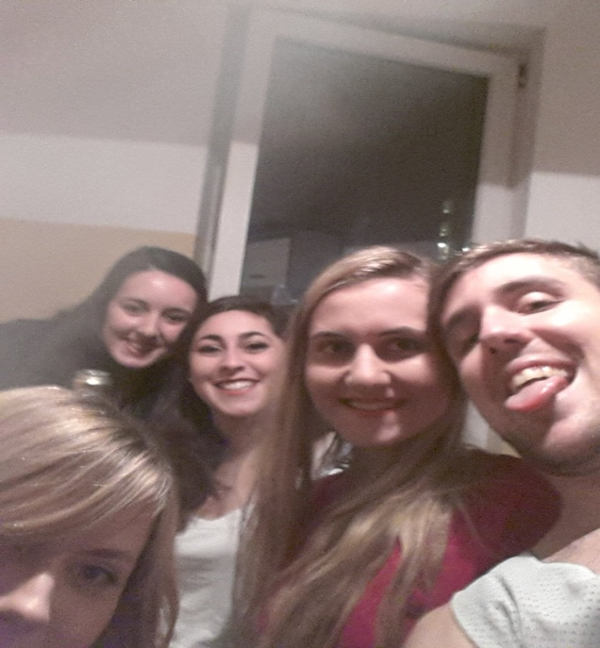
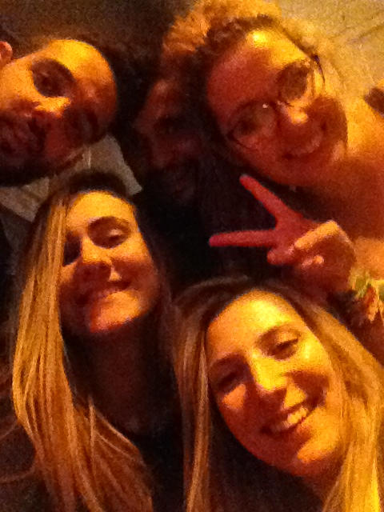
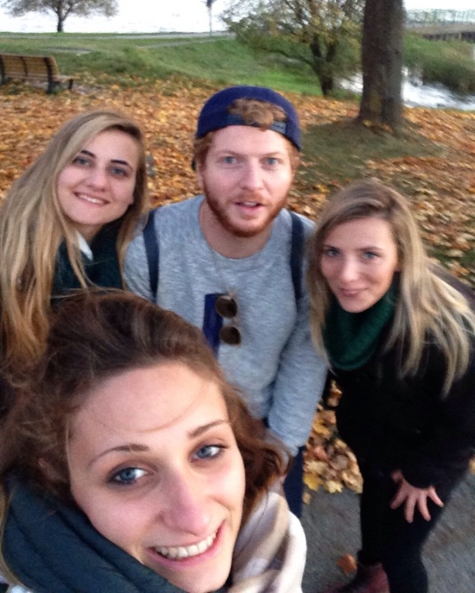
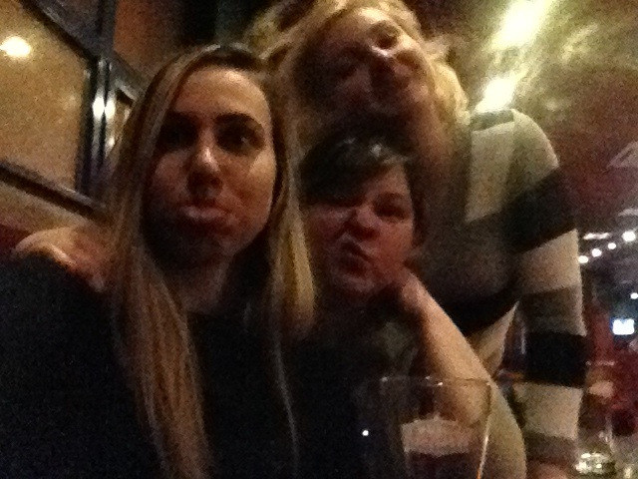
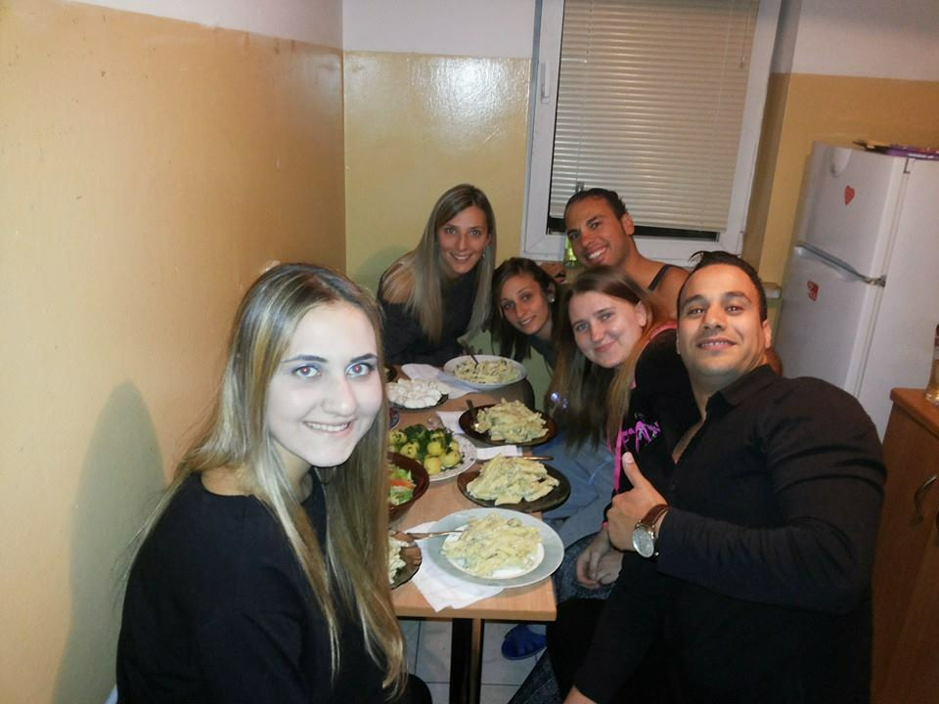
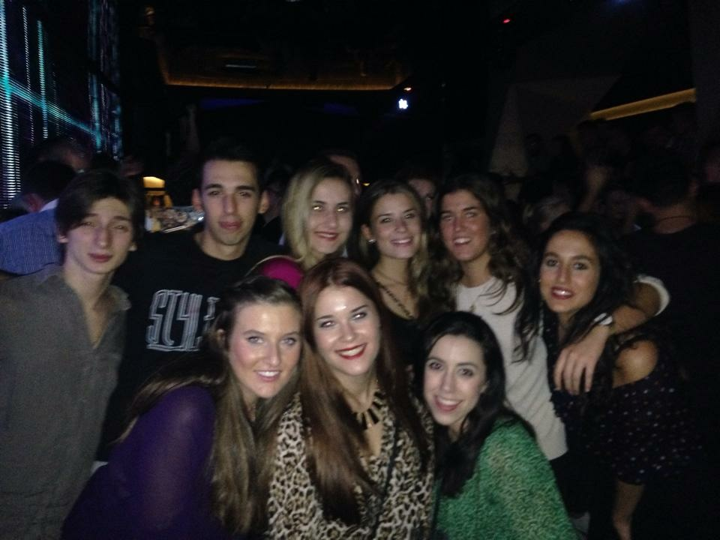


And I met unforgettable FRIENDS …

Slide 19
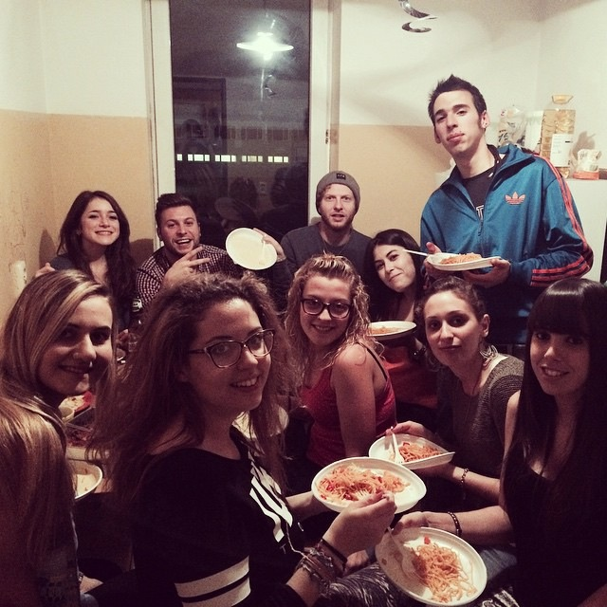
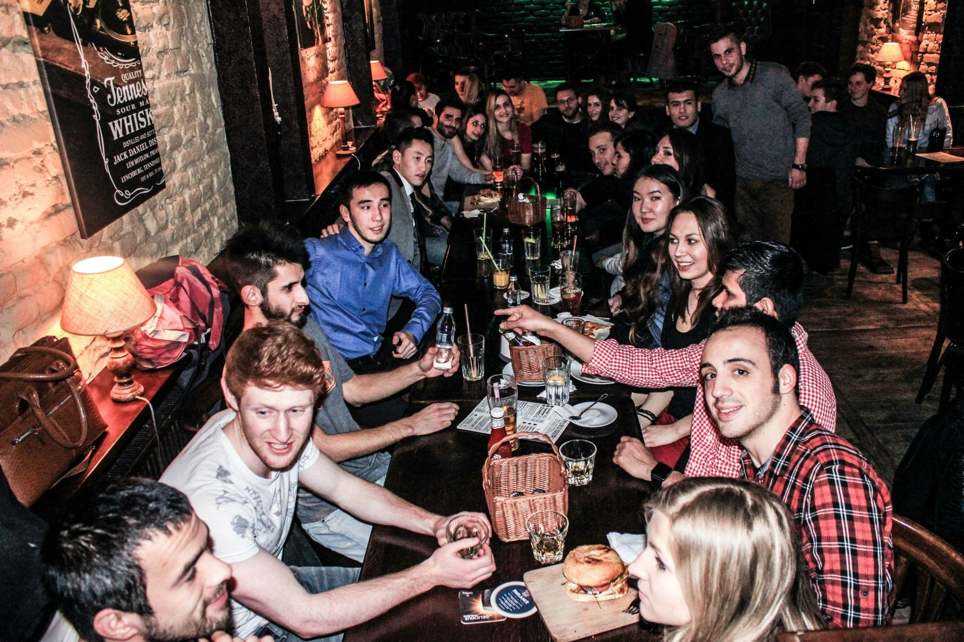
All Over the world…
I could compare different cultures
I could know different traditions
I could taste international dishes
And above all, I could learn more from each of them

Slide 20

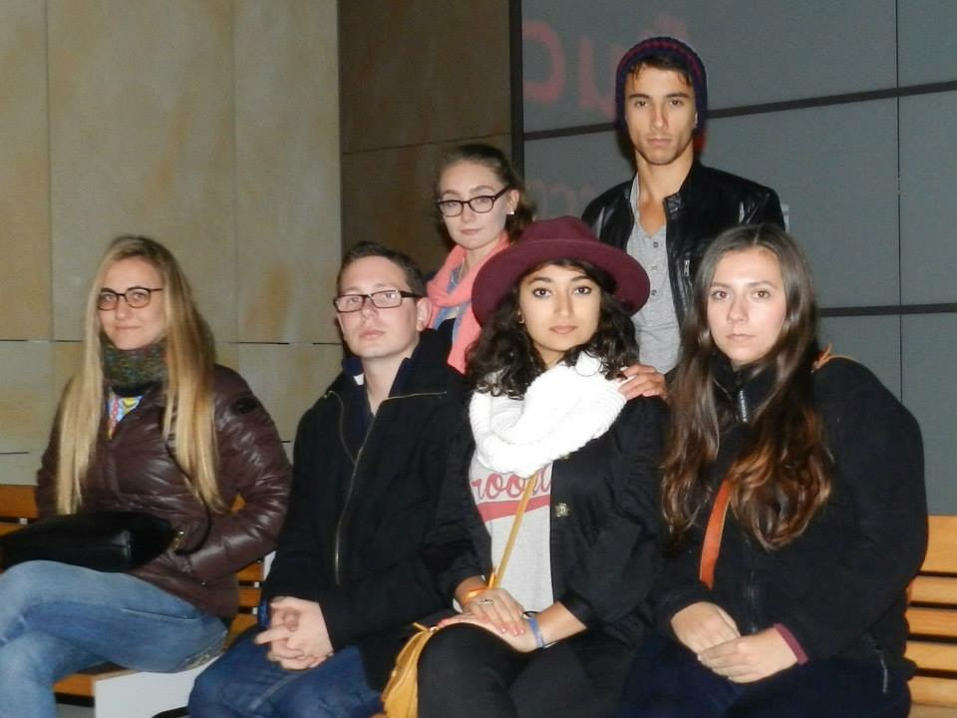











Slide 21


I enjoyed every single moment ☺

Slide 22



Slide 23

I visited wonderful cities in Poland

Slide 24


Discovering a beauty that I couldn’t imagine…

Slide 25




Slide 26

With its ART…

Slide 27


HISTORY…
TREASURES…

Slide 28



and CULTURE…

Slide 29

And I had the possibility to travel for low prices to other countries…

Slide 30




Slide 31

And I will never forget my Christmas in Poland…

Slide 32



In a kind and hospitable family…

Slide 33


BEST TIME EVER!!!

Slide 34

It’s difficult to describe what I’ve been feeling there…
HAVE YOU EVER EXPERIENCED SOMETHING SO INCOMPREHENSIBLE?
I CAN ONLY SAY THAT...

Slide 35


HALF OF MY HEART IS THERE!!!

Slide 36


Slide 37
THANK YOU KUL ☺
THANK YOU KUL ☺
THANK YOU KUL ☺
THANK YOU KUL ☺
THANK YOU KUL ☺
THANK YOU KUL ☺
THANK YOU KUL ☺
THANK YOU KUL ☺
THANK YOU KUL ☺
THANK YOU KUL ☺
THANK YOU KUL ☺
THANK YOU KUL ☺
THANK YOU KUL ☺
THANK YOU KUL ☺
THANK YOU KUL ☺
THANK YOU KUL ☺
THANK YOU KUL ☺
THANK YOU KUL ☺
THANK YOU KUL ☺
THANK YOU KUL ☺
THANK YOU KUL ☺
THANK YOU KUL ☺
THANK YOU KUL ☺
THANK YOU KUL ☺
THANK YOU KUL ☺
THANK YOU KUL ☺
THANK YOU KUL ☺
THANK YOU KUL ☺
THANK YOU KUL ☺
THANK YOU KUL ☺
THANK YOU KUL ☺
THANK YOU KUL ☺
THANK YOU KUL ☺

