Slide 1
Schengen Cooperation
Introduction
Anna Szachoń-Pszenny, PhD, Assistant Professor Department of European Union Law Faculty of Law, Canon Law and Administration John Paul II Catholic University of Lublin

Slide 2
Schengen - associations
What do you have on your mind when I say „Schengen”, have you got any associations ?
- borders,
- control,
- village in Luxembourg,
- Luxembourg-France-Germany tri-border area (tripoint) „trójstyk”
- freedom,
- free movement of persons,
- agreement,
- security.

Slide 3
A small village in Luxembourg
A small village on the Luxembourg Moselle gives its name to the 'Schengen Agreements', which progressively allowed Europeans to freely travel across borders. Located at the Luxembourg-France-Germany tri-border area (tripoint), Schengen symbolises the free movement of people and goods and the abolition of internal borders in Europe. For millions of people, Schengen is synonymous with the quality of life.
From The official port of the Grand Duchy of Luxembourg: http://www.luxembourg.public.lu/en/le-grand-duche-se-presente/luxembourg-monde/luxembourg-europe/schengen/index.html

Slide 4
Schengen Area -1985
14th June 1985: the Schengen Agreement
The signature took place on the cruise ship M.S. Marie-Astrid while moored at the quay in the charming wine-village of Schengen.
Once mainly known for its vineyards, Schengen is now synonymous with people’s right to move freely between 26 European countries.
Sitting at the convergence of the Benelux economic union, Germany and France, the location of this village is highly symbolic.

Slide 5
Schengen - the birthplace of a Europe without borders
The name Schengen is synonymous with open borders and unrestrained mobility.
The Schengen Agreement is considered worldwide as a milestone on the path to a united Europe.
Its signing in 1985 on board of MS Princesse Marie-Astrid was indeed a momentous event in the European history.
Schengen was chosen because of its ideal location in the Three-Border-Region.
The abolition of controls at the internal frontiers consolidated the Member States of the Schengen Area.
Now the Schengen Area counts 26 Member-States and the Agreement allows over 400 million Europeans travelling without barriers.

Slide 6
Schengen area as a symbol
In 1985 Schengen Area was started by signing the Schengen Agreement during the meeting of vice-ministers in a small village Schengen.
At that time in Europe they even couldn’t think about such a succes of Schengen area, which concerns almost all EU member states.

Slide 7
Interview with Roger Weber, Schengen mayor
Europa bez szlabanów
https://www.tygodnikprzeglad.pl/europa-bez-szlabanow/
– Znajduje się pan na liście najbardziej popularnych burmistrzów na świecie, obok takich postaci jak burmistrzowie Nowego Jorku, Chicago, Berlina czy Tokio. Powód jest oczywisty: zainicjowany w 1985 r. w pańskim mieście proces tworzenia Europy bez granic. Jak pan się czuje z tą popularnością?
Roger Weber is on the list of the most popular mayors on the world, next to mayors of New York, Chicago or Tokio. The reason is obvious: iniciated in 1985 process of creation „Europe without borders”

Slide 8
Interview with Roger Weber, Schengen mayor
– Pamięta pan, jak rozumiem, historyczną konferencję w 1985 r.
– To jasne. Było to dla nas duże wydarzenie, mimo że uczestniczyli w nim „tylko” wiceministrowie spraw zagranicznych Beneluksu, Francji i Niemiec. Była to umowa o znoszeniu kontroli na wspólnych granicach pomiędzy krajami-sygnatariuszami. Jej podpisanie odbyło się dokładnie 14 czerwca 1985 r., przy wspaniałej pogodzie, na pokładzie statku „Princesse Marie-Astrid”, na wodach naszej Mozeli.
-Do you remember that historical conference in 1985?
- Of course. It was a big event, despite the fact that„only” vice-ministers of foreign affairs of Benelux, France and Germany took part in it. It was an Agreement between the Governments of the States of the Benelux Economic Union, the Federal Republic of Germany and the French Republic on the gradual abolition of checks at their common borders. On 14th June 1985 the Schengen Agreement was signed. This happened on the boat Princess Marie-Astrid in the middle of the river Moselle. Here, the borders of France, Germany and Luxembourg meet.

Slide 9
Interview with Roger Weber, Schengen mayor
– Jaki ten układ miał wpływ na życie mieszkańców Schengen? Jak go odczuwali na własnej skórze, przekraczając pobliskie granice? – Kontrole graniczne zaczęły być stopniowo ograniczane wkrótce po podpisaniu układu, jeszcze w 1985 r. Od 1986 r. była to już tylko kontrola wzrokowa pojazdów, które na przejściu granicznym jedynie zwalniały. Oczywiście wszyscy to chwalili i korzystali z udogodnień bardzo chętnie. Fakt, że to się zaczęło w Schengen, był nam wszystkim bardzo miły.
- What influence had this Agreement on Schengen habitans’ life? What did they feel first-hand when crossing nearby borders?
- Border controls started to be gradually limited soon after the signing of the Agreement, back in 1985. Since 1986, it was only a visual check of vehicles, which at the border crossing only slowed down. Of course, everyone praised and used the facilities very willingly. The fact that it started in Schengen was very nice to all of us.

Slide 10
Interview with Roger Weber, Schengen mayor
– Czy spodziewał się pan, że kiedykolwiek porozumienie to może objąć także kraje Europy Środkowo-Wschodniej? Czy to nie jawiło się jako jakaś bajka andersenowska? – Oczywiście w czasie, kiedy porozumienie się rodziło, nikt nie był w stanie przewidzieć jego konsekwencji z lat późniejszych. W tym także tych związanych z wyłonieniem się nowych pretendentów z grona państw postkomunistycznych. Warto znów przypomnieć fakt, że sami przywódcy polityczni krajów sygnatariuszy nie zakładali takiej dynamiki sytuacji, przysyłając do podpisania porozumienia tylko swoich wiceministrów. Skutki przerosły wszelkie wyobrażenia.
- Did you expect that this Agreement could also be extended to the Central and East European states? Did not it appear as a fairy tale?
- Of course, at the time when the Agreement was born, no one was able to predict its consequences for later years. Including those related to the emergence of new contenders from the group of post-communist states. It is worth recalling again that the political leaders themselves of the signatory countries did not assume such a dynamic situation by sending only their vice ministers to sign the agreement. The effects have surpassed all expectations.

Slide 11
Schengen Area by European Commission
European Commission about Schnegen Area:
Schengen Area - European Union Home Affairs (film)
https://www.youtube.com/watch?v=uz4vlS1QGhw

Slide 12
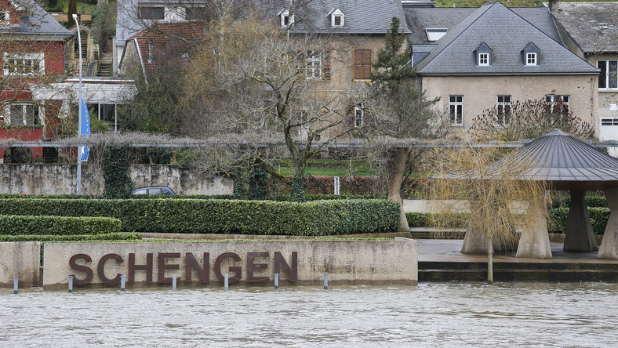
Schengen village

Slide 13
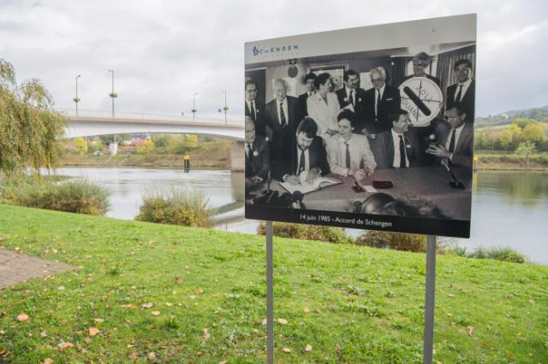
Schengen Agreement – 14th June 1985

Slide 14
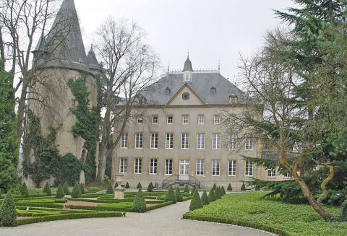
Schengen castle

Slide 15
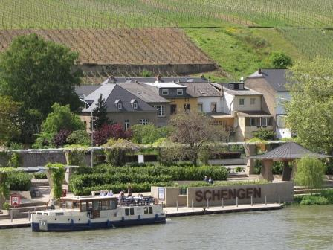
Schengen vineyards

Slide 16
Schengen wines made from grapes grown in 3 countries
With its unique position in the Three Border Region, Schengen will provide you with a first-hand experience of the European spirit - its award-winning wines, made from grapes grown in three countries.

Slide 17
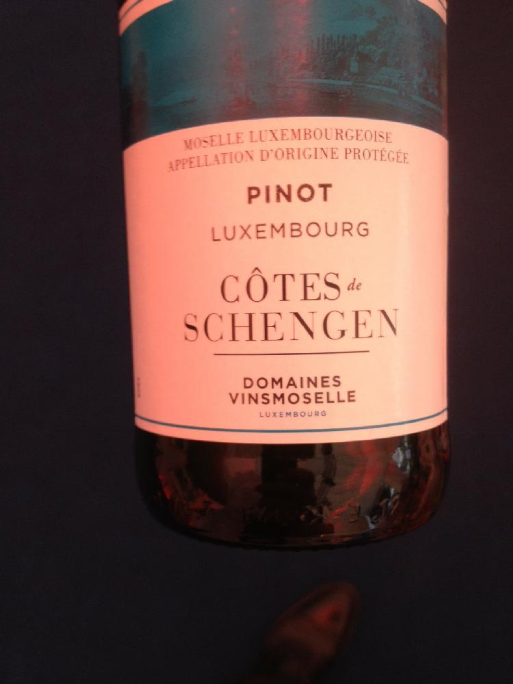
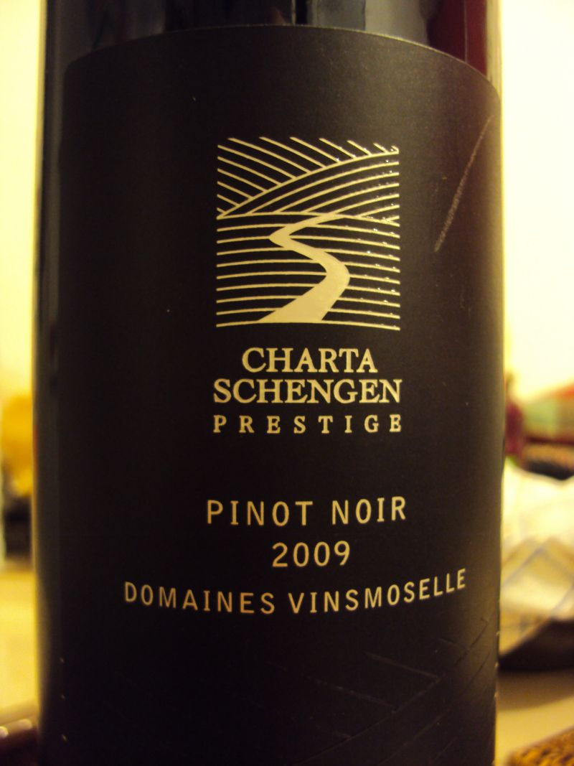
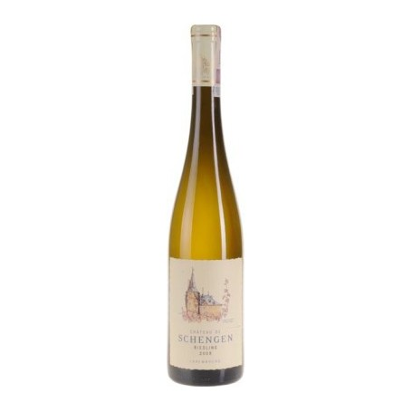
Schengen wines- the most politicized wines in the world

Slide 18
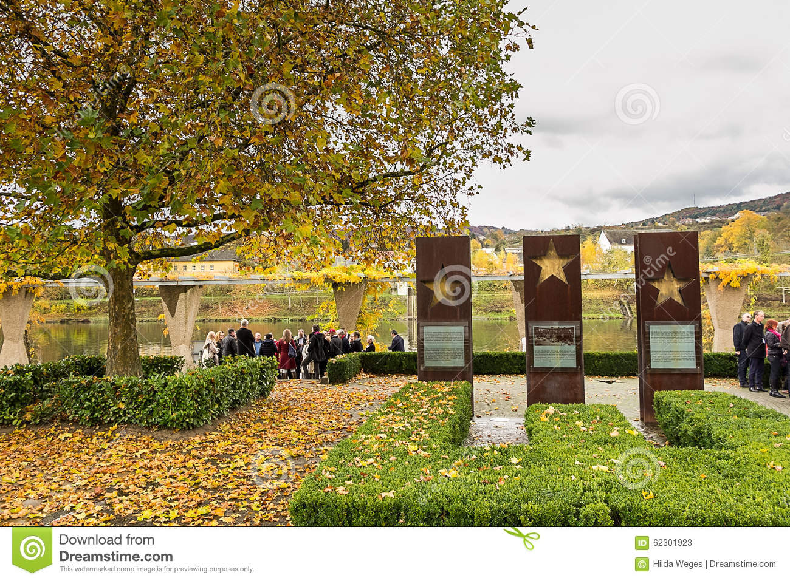
Schengen monument

Slide 19
Monument 'Schengen Agreements'
On the esplanade along the Moselle in Schengen, 3 steel pillars commemorate the signature of the Schengen Agreements in 1985 and 1990.
The wine-growing village of Schengen was eventually chosen for the signature ceremony of the Schengen Agreements because it is located on the border between France, Germany and the economic union Benelux (thus the first 5 signatories of the protocol).

Slide 20
How the Schengen area was created
How the Schengen area was created - BBC News
http://www.bbc.com/news/world-europe-13194723

Slide 21
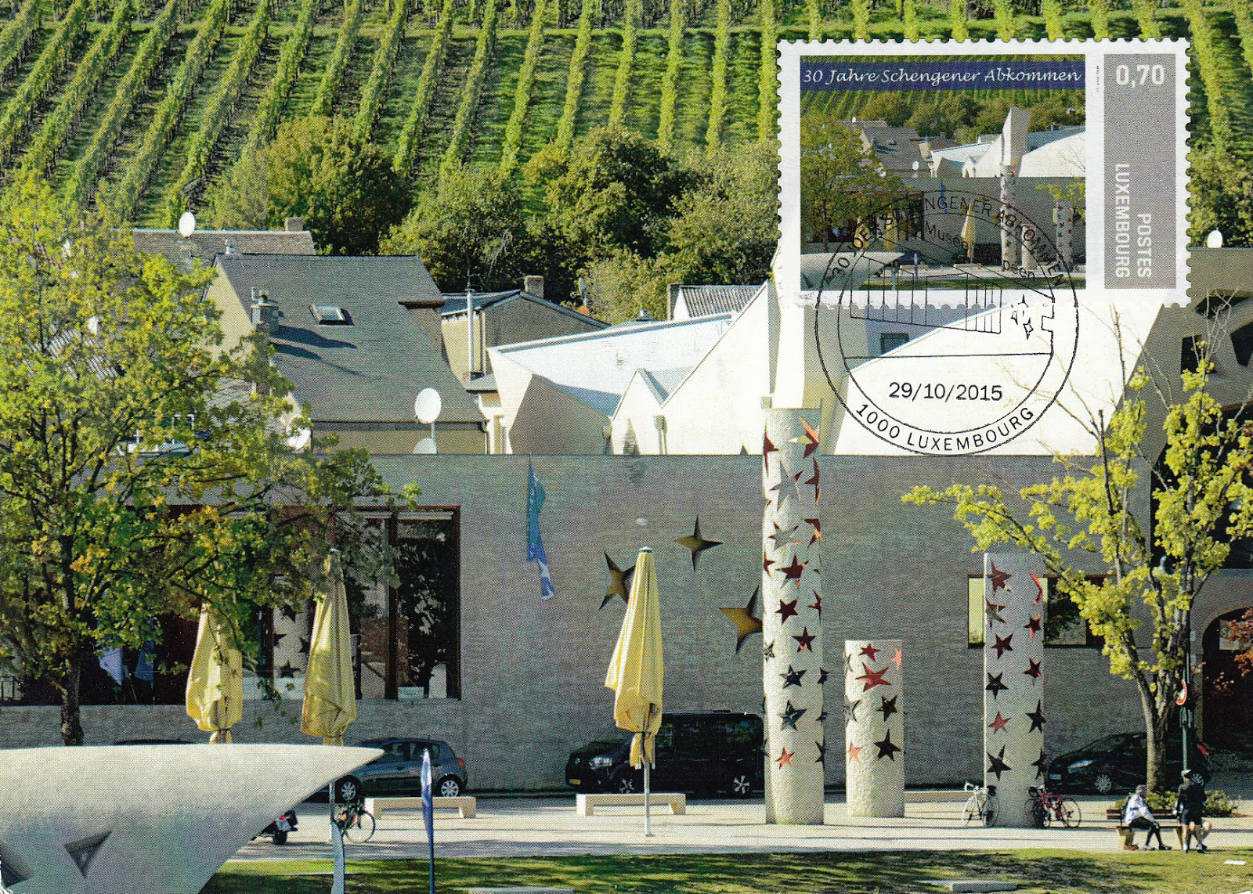
European Museum Schengen

Slide 22
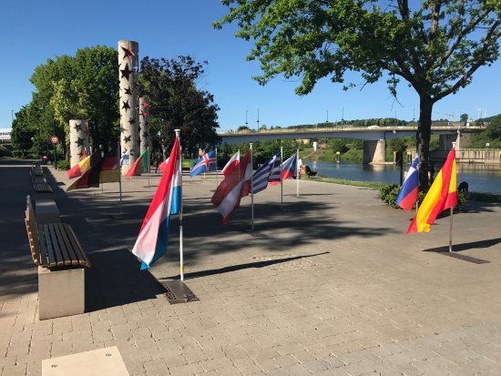
European Museum Schengen

Slide 23
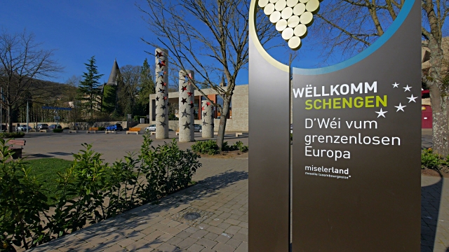
European Museum Schengen

Slide 24
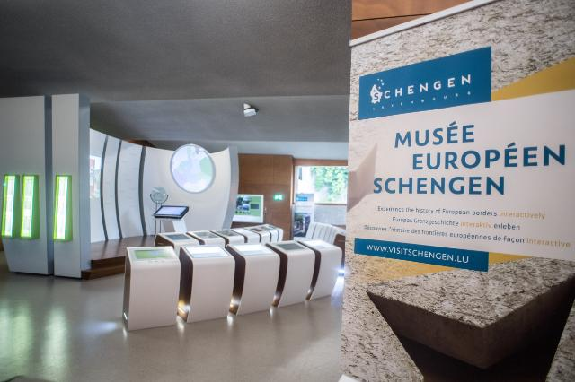
European Museum Schengen

Slide 25
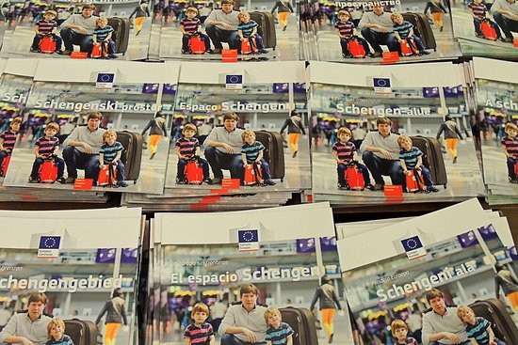
European Museum Schengen

Slide 26
European Museum Schengen
Inaugurated on 13th June 2010, 25 years after the signing of the Schengen Agreements,
It is dedicated to the history and significance of the Schengen Agreements.
On 200m2, a permanent exhibition shows visitors that the abolition of internal border controls was the beginning of the implementation of one of the 4 fundamental liberties that had been fixed by the Treaty of Rome of 1957.
All of the texts of the exhibition are in German, English and French. Admission is free.

Slide 27
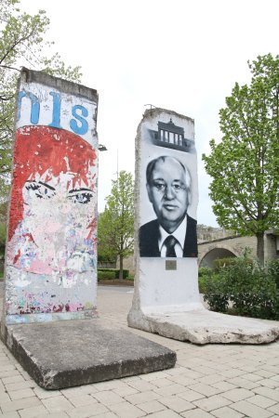
The Berlin Wall- Schengen Implementation Agreement 1990/1995
SIA was signed in 1990, entered into force in 1995 due to the reunification of Germany
Fragments of the Berlin Wall
in front of the European Museum Schengen

Slide 28
Schengen Implementation Agreement 1990/1995
Schengen Implementation Agreement (SIA)
Signed 19th June 1990, entered into force 26th March 1995
Convention implementing the Schengen Agreement of 14th June 1985 between the Governments of the States of the Benelux Economic Union, the Federal Republic of Germany and the French Republic on the gradual abolition of checks at their common borders, Official Journal L 239 , 22/09/2000

Slide 29
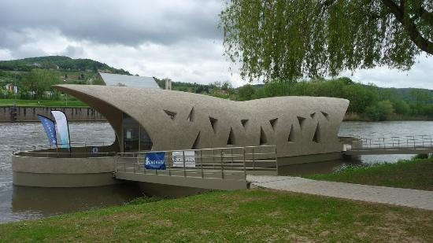
Schengen still developing in the context of the Schengen Agreement
A new pontoon on the River Moselle accommodating the Tourist Information Centre was completed in 2015 for the 30th anniversary of the signing.

Slide 30
Schengen Area in numbers
Members | 26 states
Population | 419,392,429
Area | 4,312,099 km² (1,664,911 sq mi)
Policy of | European Union

Slide 31
Schengen area – borders on maps
Through Schengen Area, borders between European countries exsist only on maps, as to over 400 million people of 26 member countries the freedom of movement is guaranteed.
Borders as an administrative fact still exist, but there are no border control on internal borders.

Slide 32
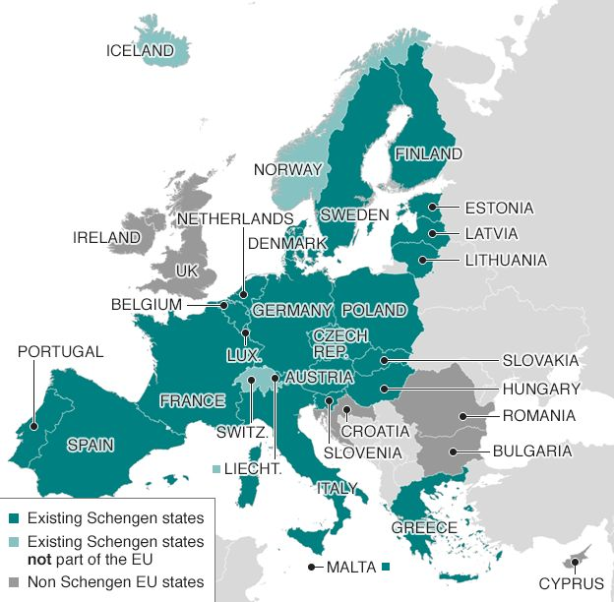
Schengen Area Member States

Slide 33
Schengen Area Member States
Film
Schengen Countries
https://www.youtube.com/watch?v=g5wE6CZJx1A

Slide 34
Websites about Schengen
www.luxembourg.public.lu
www.schengenvisainfo.com
www.visitluxembourg.com

Slide 35
Check questions
Have you got any associations with Schengen?
What is Schengen known for?
When the Schengen area was created?
Under what circumstances the Schengen area was created?
How many states are there in the Schengen area?

