Slide 1
Baby acoustics

Slide 2
Speech chain
Articulation Propagation Perception
| | |
Articulatory Acoustic Auditory
Phonetics Phonetics Phonetics

Slide 3
Vowels - Articulatory parameters
front central back
High
Mid
Low
i:
u:
ɪ
ʊ
ə
e
ɔ:
ɜ:
ʌ
ɒ
æ
ɑ:

Slide 4
Consonants – articulatory parameters
Voicing: (voiced, voiceless)
Manner: (plosive, fricative, liquid, glide, etc.)
Place: (labial, alveolar, palatal, velar, etc.)

Slide 5
Basic acoustics

Slide 6
Vowels: periodic sounds
Amplitude (dB)
Frequency (Hz)
dB = amount of displacement from rest position
1Hz = 1 cycle per second (cps)
F0 (fundamental frequency = 1st harmonic)

Slide 7
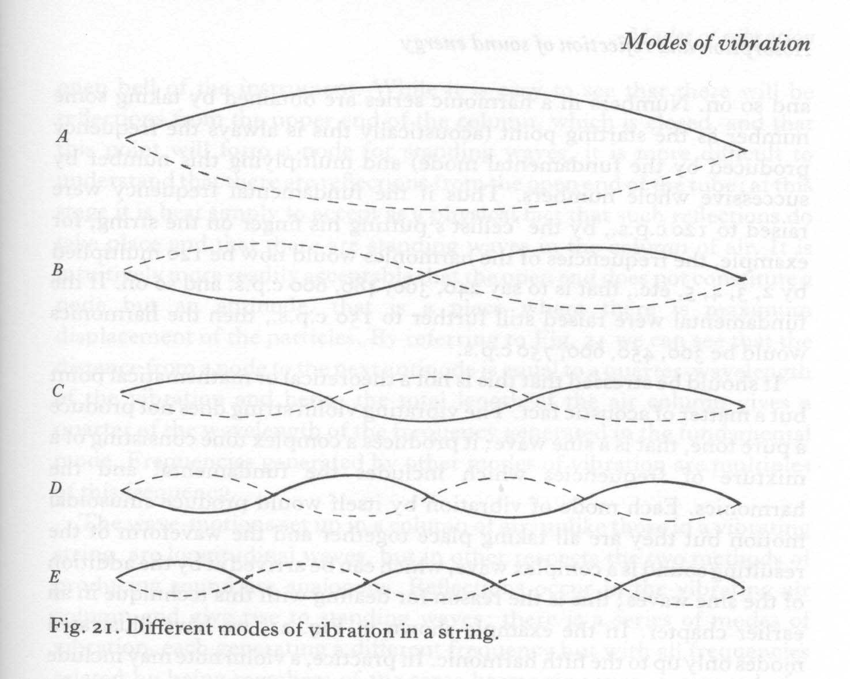
Harmonics are multiples of F0
1st 150Hz
2nd 300Hz
3rd 450Hz
4th 600Hz
5th 750Hz

Slide 8
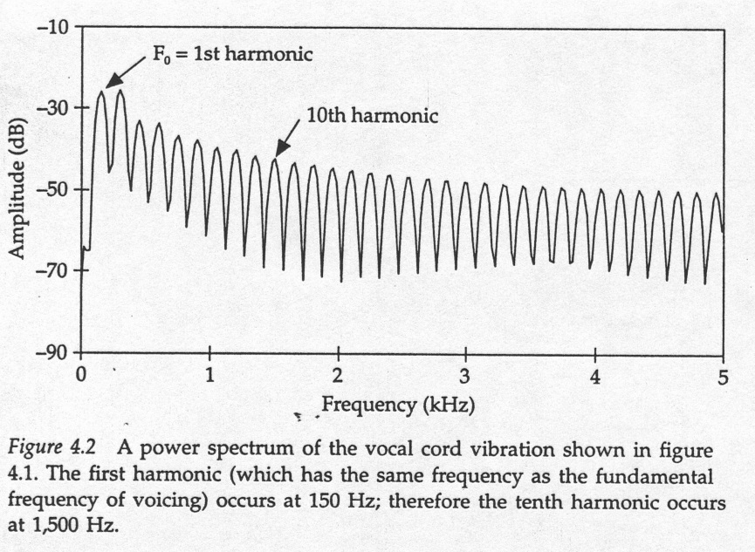
Power spectrum

Slide 9
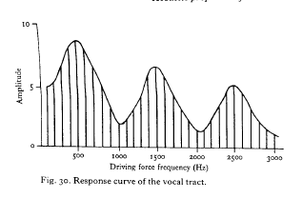
What is schwa?
F1 F2 F3

Slide 10
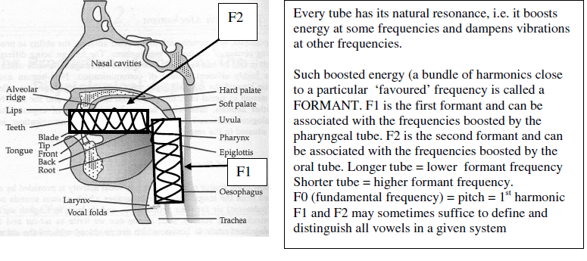
Vocal tract produces formants…

Slide 11
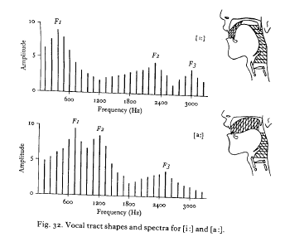
[i:] and [a:]

Slide 12
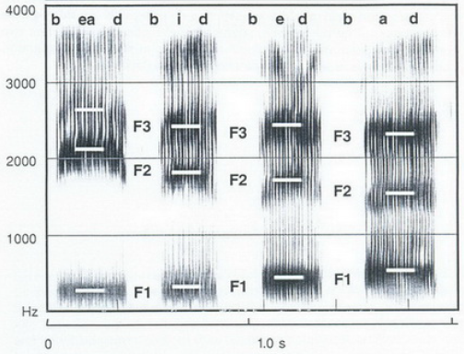
bead, bid, bed, bad

Slide 13
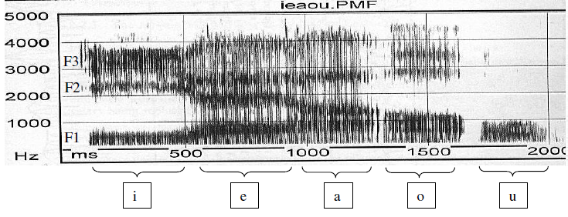
Polish vowels

Slide 14
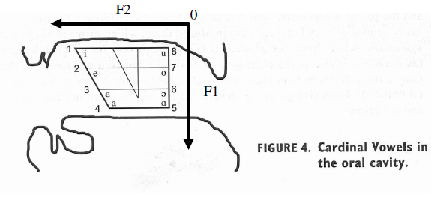
Describing vowels in terms of formants

Slide 15
Voicing in phonetics
  aerodynamics of voicing
  articulatory gestures
  acoustic cues

Slide 16
  Aerodynamic conditions on voicing
…………
…
…
P1 > P2
      oral and nasal exit
………………………
…
…
…
…
P2
  Larynx and vocal cords
P1
sonorants
P1 > P2
obstruents
P1 = P2
Conclusion:
Voicing of vowels and sonorants (m l r j w) is spontaneous
Voicing of obstruents (b d g z v) requires additional active gestures…

Slide 17
Articulatory gestures and voicing in obstruents
Facilitating voicing (lenis)
Inhibiting voicing (fortis)
Increased P1 ↑
Decreased P1 ↓
Lowered larynx ↓
Raised larynx ↑
Short closure
Long closure
Relaxed facial muscles
Tense facial muscles
Slack vocal cords
Stiff vocal cords
Spread vocal cords

Slide 18
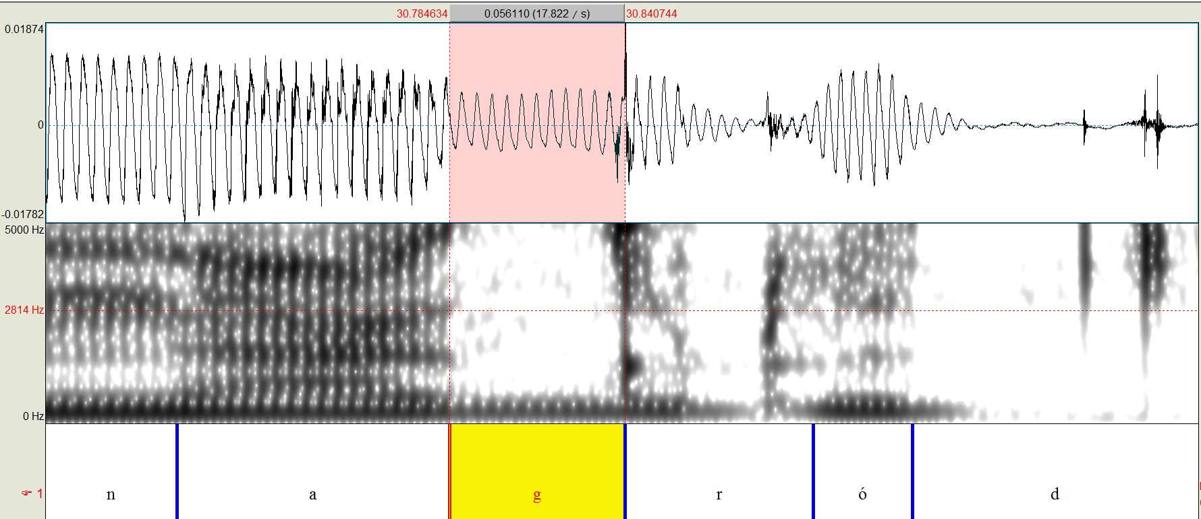
CPP nagród

Slide 19
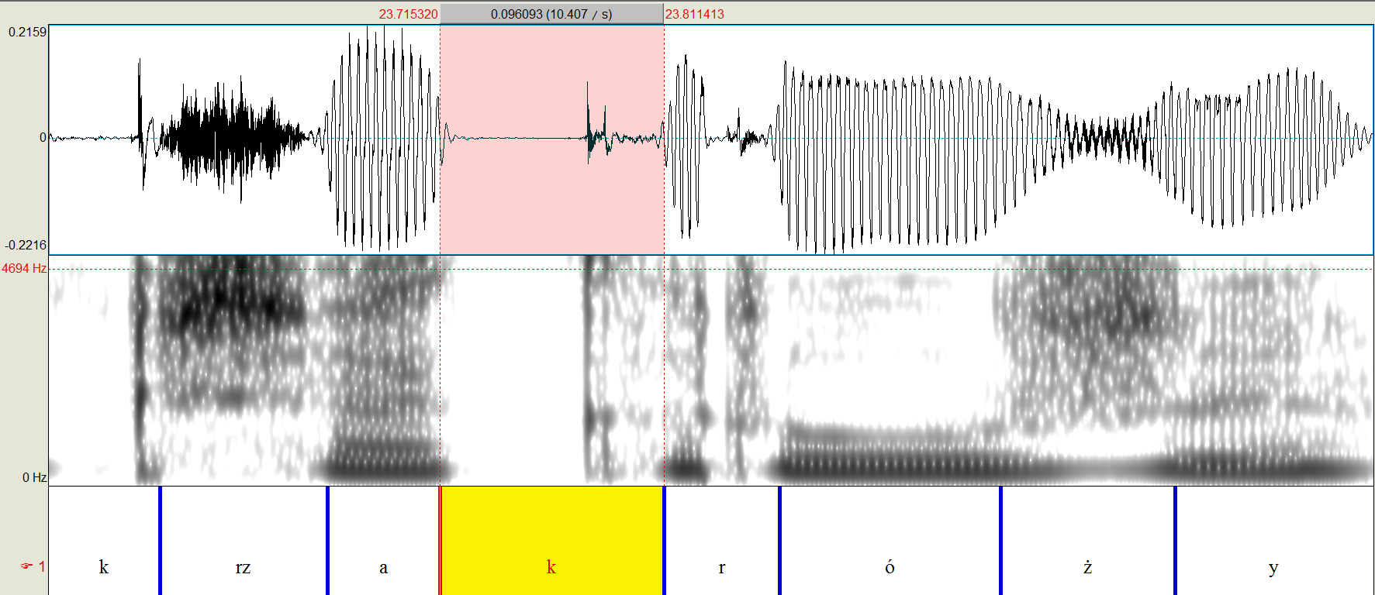
WP krzak róży (10) /k#r/ > [kr]

Slide 20
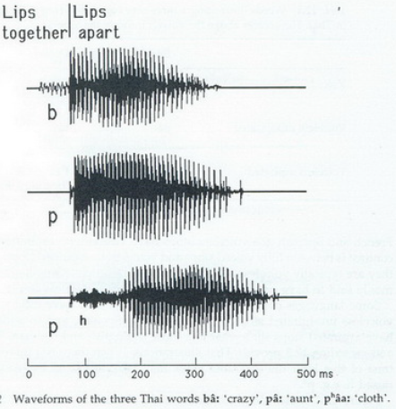
3 types of VOT (Voice Onset Time)

Slide 21
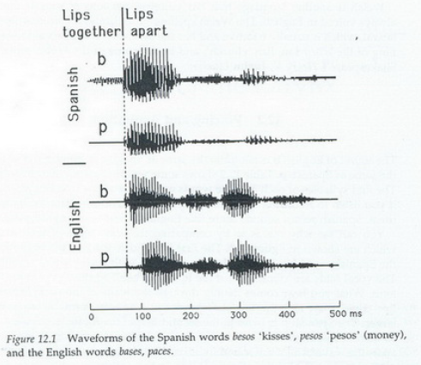
Compare Polish and English VOT

Slide 22
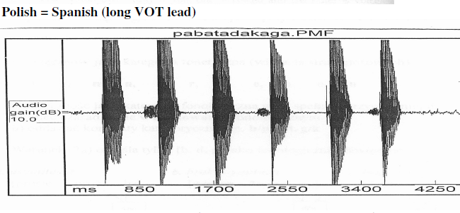
pa ba ta da ka ga

Slide 23
Phonetic categories and acoustic cues
closure release
③
②
④
①
    vowel vowel
    ④
t
[d] [t] [t^{h}]
fully voiceless voiceless
voiced unaspirated aspirated
① Vowel duration
② Closure duration
③ Burst and its intensity
④ VOT (voicing / aspiration)
VOT lag
VOT lead

Slide 24
Phonetic categories and acoustic cues
closure release
③
②
④
①
    vowel vowel
    ④
t
[d] [t] [t^{h}]
fully voiceless voiceless
voiced unaspirated aspirated
① Vowel duration
② Closure duration
③ Burst and its intensity
④ VOT (voicing / aspiration)
#
VOT lag
VOT lead

Slide 25
Phonetic categories and acoustic cues
closure release
③
②
④
①
    vowel vowel
    ④
t
[d] [t] [t^{h}]
fully voiceless voiceless
voiced unaspirated aspirated
① Vowel duration
② Closure duration
③ Burst and its intensity
④ VOT (voicing / aspiration)
#
VOT lag
VOT lead

Slide 26
Manner
Vowels are formants of periodic energy
Plosives are silence…

Slide 27
WP krzak róży (10) /k#r/ > [kr]

Slide 28
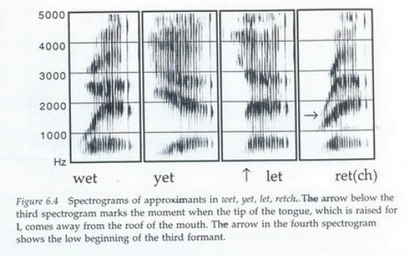
Approximants have formants

Slide 29
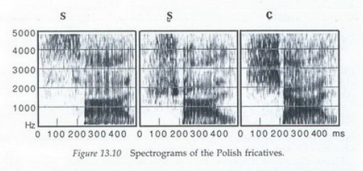
sali, szali, siali

Slide 30
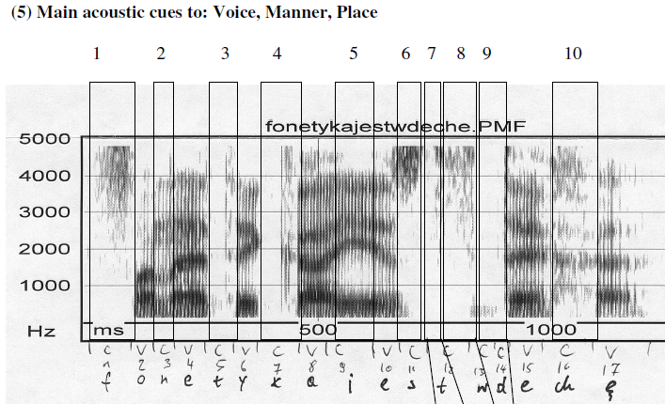
Fonetyka jest w deche !

Slide 31
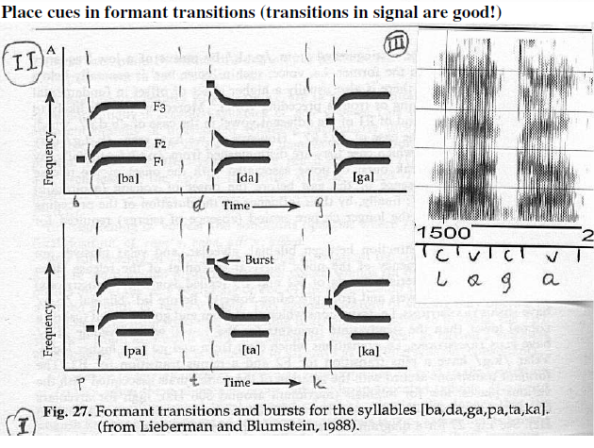
Place cues in acoustic signal

Slide 32
Place of articulation

Slide 33
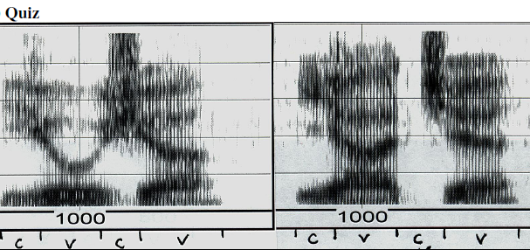
Quiz

Slide 34
Thank you!

