Slide 1
Abstract writing help
Read each question below and make your own notes which relate to Your thesis.
Use one of the proposed academic phrases to begin each answer in such a way that your answers form a coherent paragraph referring to questions 1-4
Second paragraph should refer to questions 5-7.
So far, we assume there are 2 chapters but there will be more, and everything will depend on your particular plans.

Slide 2
Planning your abstract
1. What research area does your thesis concern?
The thesis/study raises the issue of…
The thesis/study addresses the problem of …
The central problem addressed in this thesis/study is…
The main issue raised in this thesis study is…
The primary concern of this thesis/study is …
The main research area discussed in this thesis/study is …
2. What is the goal of the thesis/study?
The main/central goal/aim of this thesis/study is to…
This thesis/study aims at …ing …

Slide 3
3. What is your (general) research question?
The following research question has been formulated for this study: …
This thesis/study addresses the following research question: …
This thesis/study sets out to provide an answer to the following research question: …
4. What is your hypothesis?
It is hypothesized that …
5. What topics will be discussed in Chapter 1?
Chapter 1 discusses …
Chapter 1 presents…

Slide 4
6. What kind of research will you conduct in Chapter 2 to answer your research question?
To answer the research question
… lessons will be observed/ conducted/recorded/transcribed/described …
… a questionnaire will be administered among …
… course books for … will be analysed…
…recordings of learner speech will be made containing…
…samples of learners’ writing will be collected …
…an experiment will be conducted in which learners will …
…interviews will be conducted among…
… a (grammar/vocabulary) test will be administered among…
… an elicited imitation task will be administered among…

Slide 5
7. What data are you going to analyse? What research instruments are you going to use to collect your data?
The data analysed in Chapter 2 include:
notes from general/focused lesson observations
lesson plans with lesson descriptions and post-lesson reflections
lesson observation sheets
lesson recordings/transcripts
recordings/transcripts of learner speech
course books
other materials

Slide 6
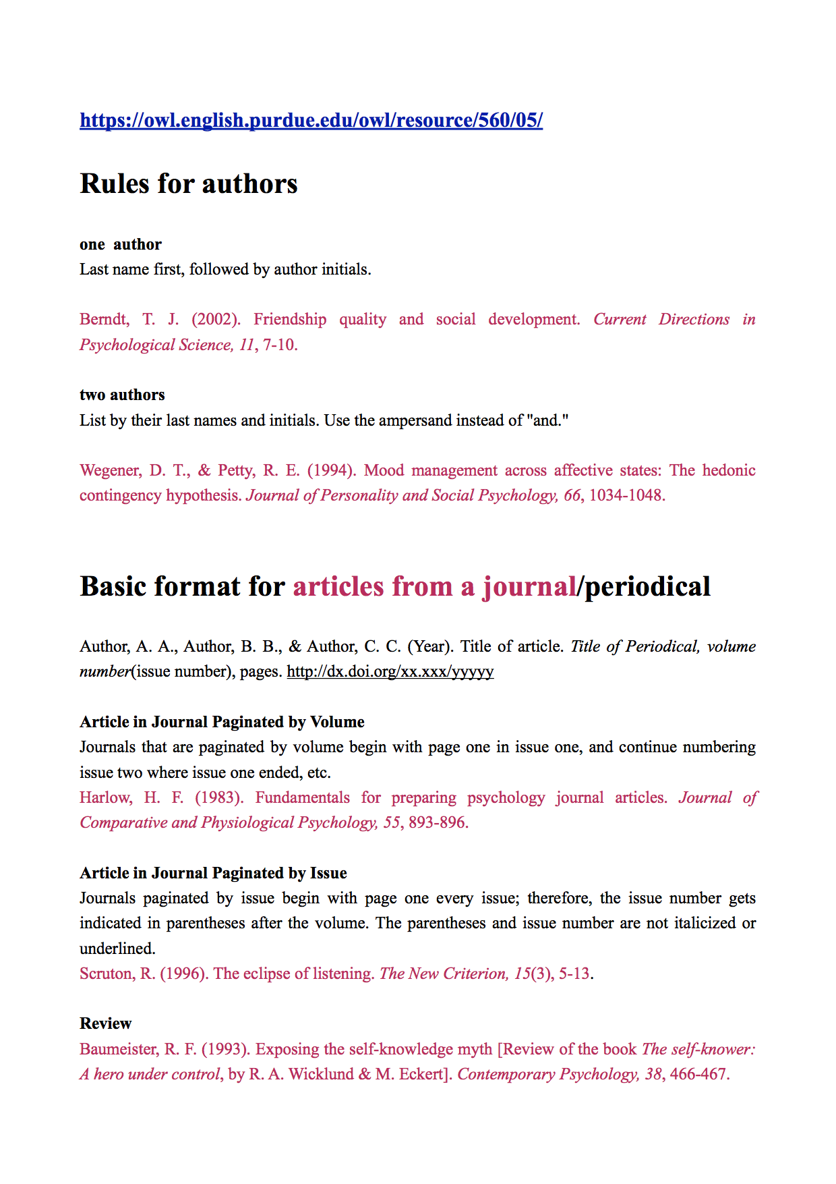
Bibliography

Slide 7
Features of academic register
goal: to inform NOT to entertain
= no poetic language, no repetition, no digressions, no personal comments or emotional remarks, no contracted forms, no phrasal verbs,
six features: complex, formal, objective, explicit, hedged (indirect), and responsible
the main emphasis is on the information that you want to give and the arguments you want to make, rather than you
it is the responsibility of the writer in English to make it clear to the reader how the various parts of the text are related

