Slide 1
Baby acoustics
Eugeniusz Cyran
KUL, Lublin

Slide 2
Speech chain
Articulation Propagation Perception
| | |
Articulatory Acoustic Auditory
Phonetics Phonetics Phonetics

Slide 3
Vowels - Articulatory parameters
front central back
High
Mid
Low
i:
u:
ɪ
ʊ
ə
ɔ:
e
ɜ:
ɒ
ʌ
æ
ɑ:

Slide 4
Consonants – articulatory parameters
Voicing: (voiced, voiceless)
Manner: (plosive, fricative, liquid, glide, etc.)
Place: (labial, alveolar, palatal, velar, etc.)

Slide 5
Basic acoustics

Slide 6
Vowels: periodic sounds
Amplitude (dB)
Frequency (Hz)
dB = amount of displacement from rest position
1Hz = 1 cycle per second (cps)
F0 (fundamental frequency = 1st harmonic)

Slide 7
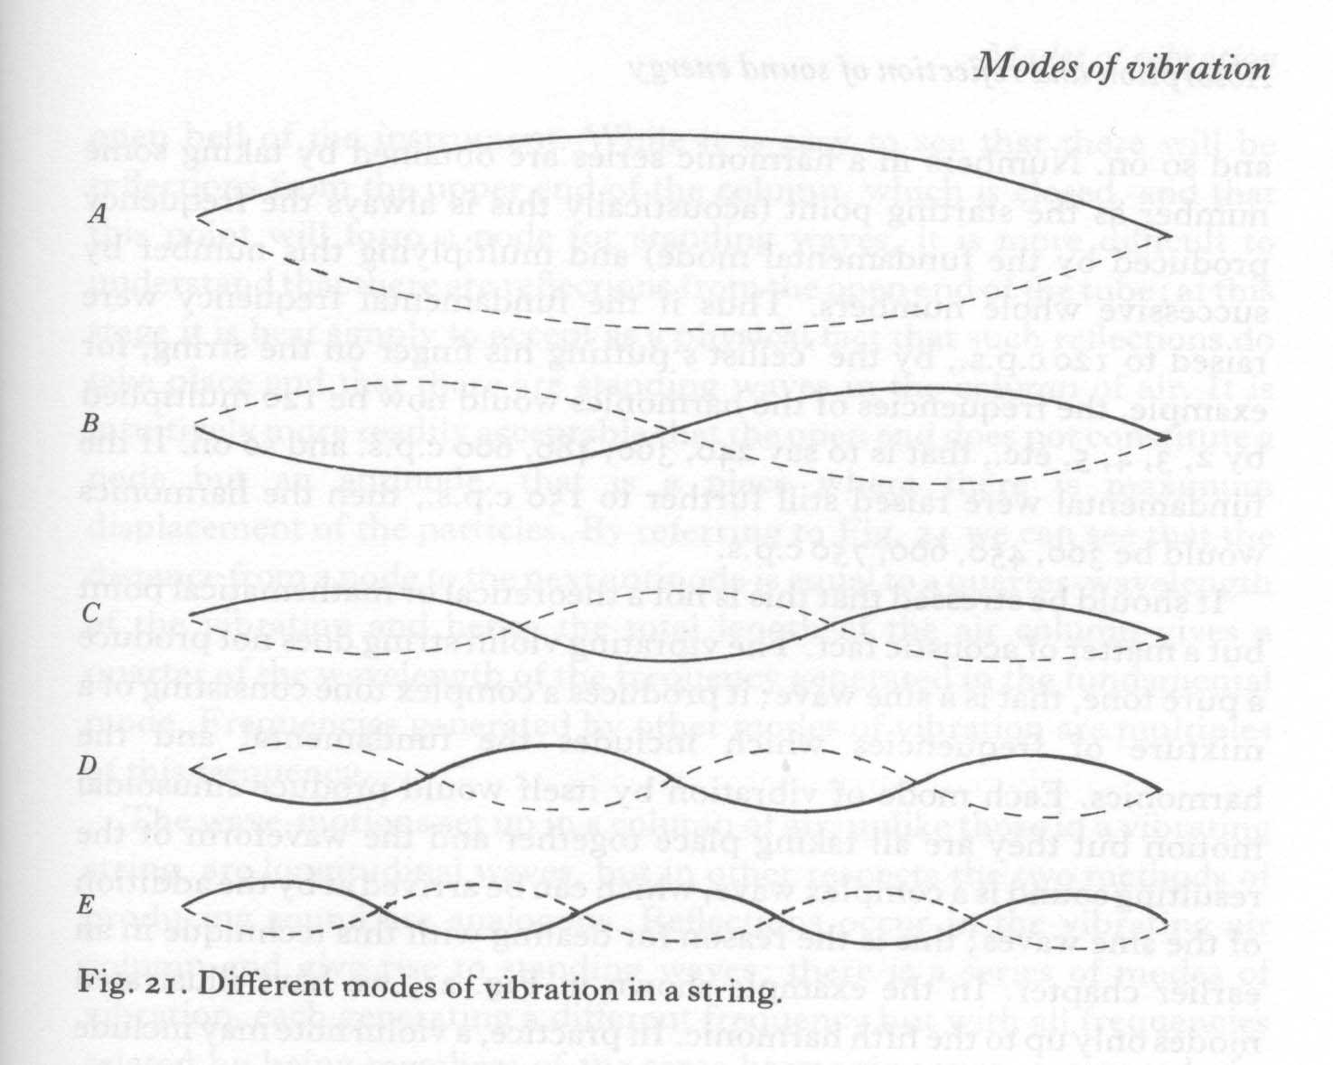
Harmonics are multiples of F0
1st 150Hz
2nd 300Hz
3rd 450Hz
4th 600Hz
5th 650Hz

Slide 8
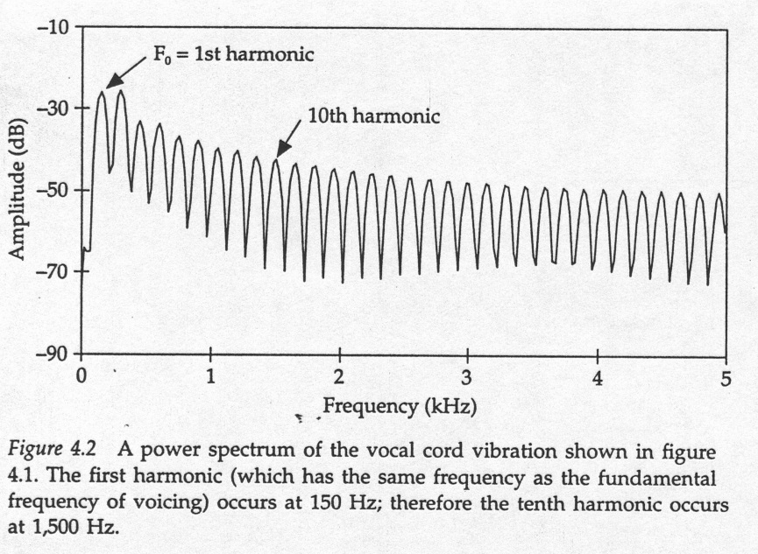
Power spectrum

Slide 9
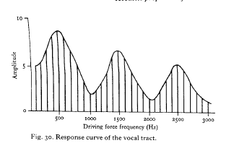
What is schwa?
F1 F2 F3

Slide 10
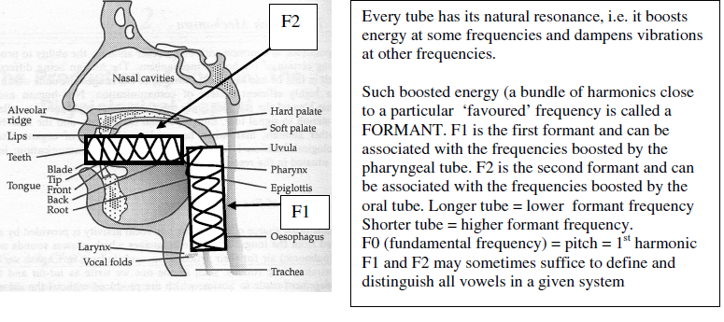
Vocal tract produces formants…

Slide 11
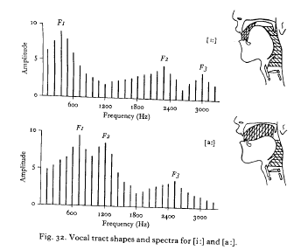
[i:] and [a:]

Slide 12
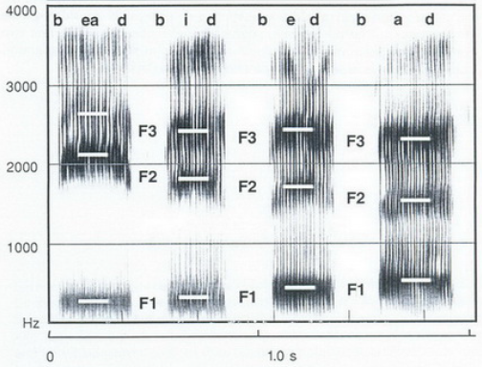
bead, bid, bed, bad

Slide 13
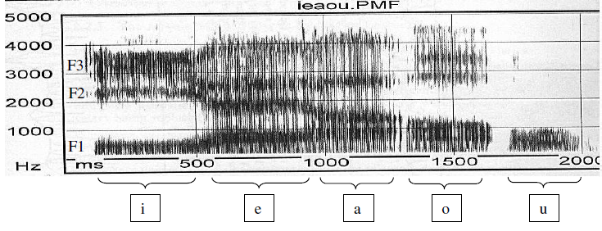
Polish vowels

Slide 14
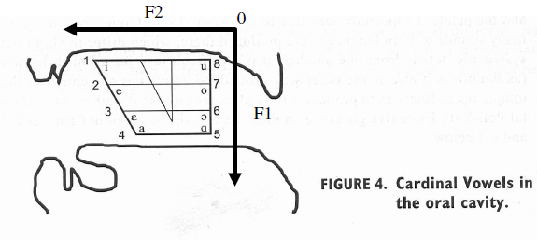
Describing vowels in terms of formants

Slide 15
Voicing in phonetics
  aerodynamics of voicing
  articulatory gestures
  acoustic cues

Slide 16
  Aerodynamic conditions on voicing
…………
…
…
P1 > P2
      oral and nasal exit
………………………
…
…
…
…
P2
  Larynx and vocal cords
P1
sonorants
P1 > P2
obstruents
P1 = P2
Conclusion:
Voicing of vowels and sonorants (m l r j w) is spontaneous
Voicing of obstruents (b d g z v) requires additional active gestures…

Slide 17
Articulatory gestures and voicing in obstruents
Facilitating voicing (lenis)
Inhibiting voicing (fortis)
Increased P1 ↑
Decreased P1 ↓
Lowered larynx ↓
Raised larynx ↑
Short closure
Long closure
Relaxed facial muscles
Tense facial muscles
Slack vocal cords
Stiff vocal cords
Spread vocal cords

Slide 18
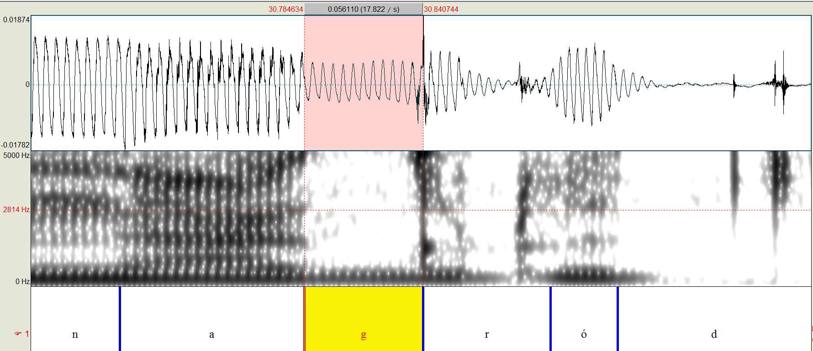
CPP nagród

Slide 19
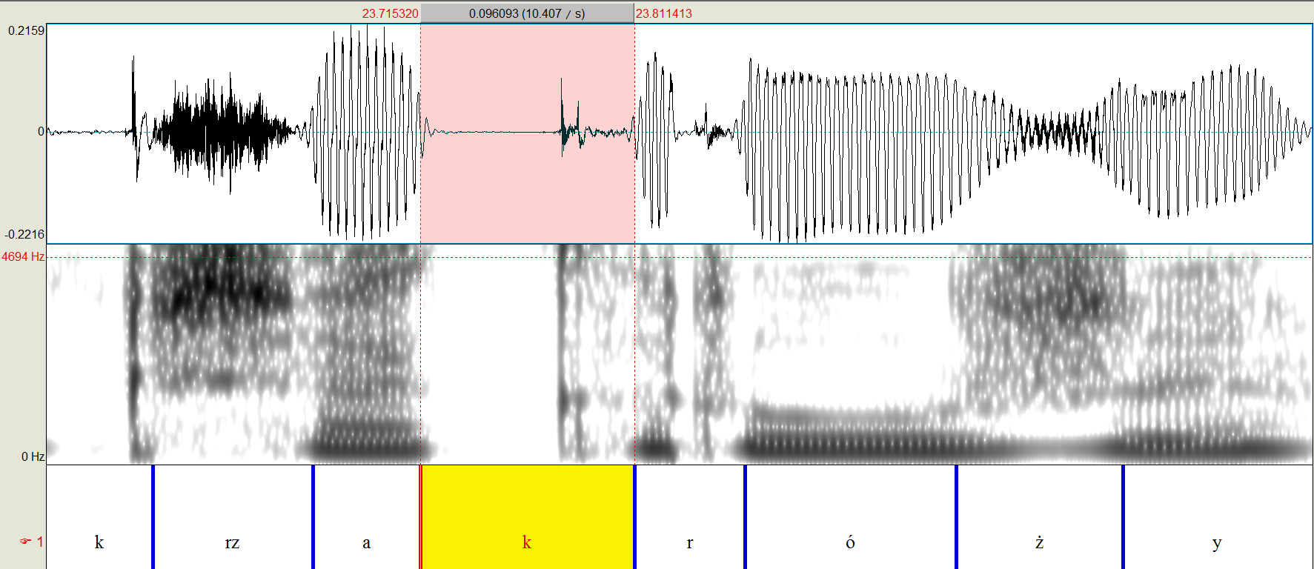
WP krzak róży (10) /k#r/ > [kr]

Slide 20
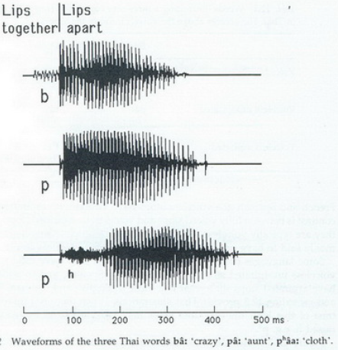
3 types of VOT (Voice Onset Time)

Slide 21
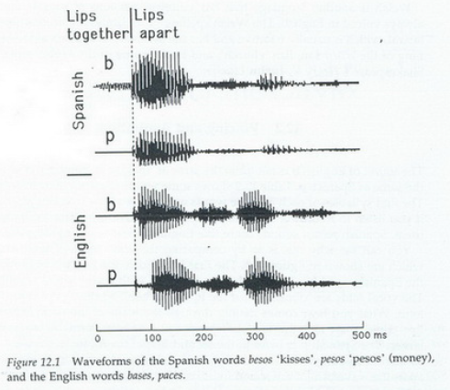
Compare Polish and English VOT

Slide 22
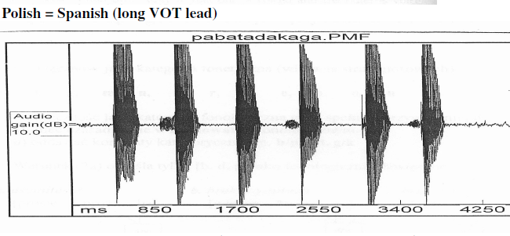
pa ba ta da ka ga

Slide 23
Manner
Vowels are formants of periodic energy
Plosives are silence…

Slide 24
WP krzak róży (10) /k#r/ > [kr]

Slide 25
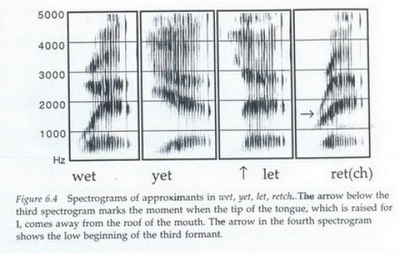
Approximants have formants

Slide 26
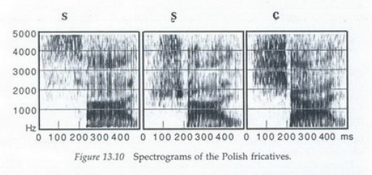
sali, szali, siali

Slide 27
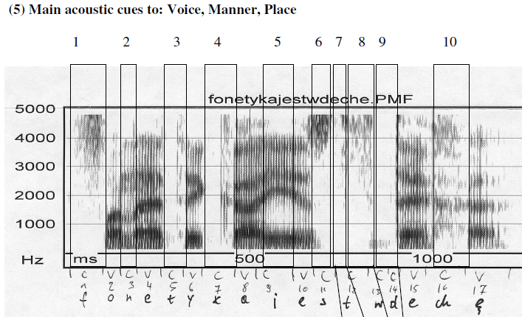
Fonetyka jest w deche !

Slide 28
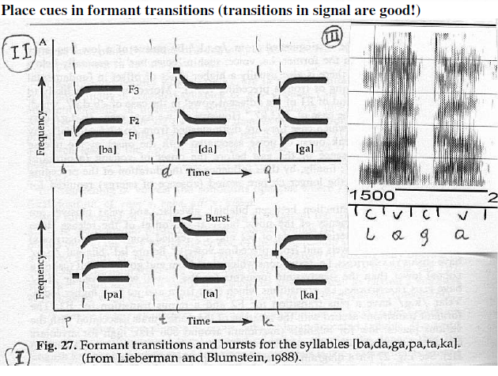
Place cues in acoustic signal

Slide 29
Place of articulation

Slide 30
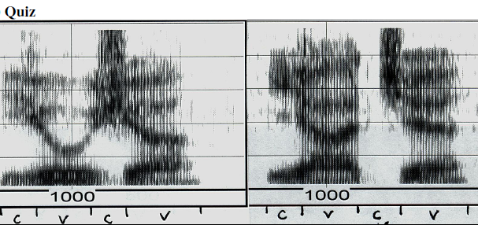
Quiz

Slide 31
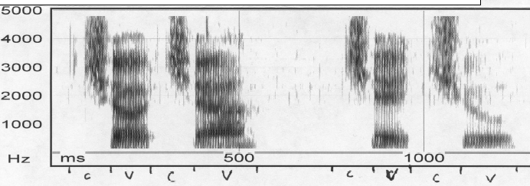
Quiz 2

Slide 32
Thank you!

